Slide 1


Slide 2
Grades Point Average (GPA)
Student GPA
Subject GPA
School GPA

Slide 3
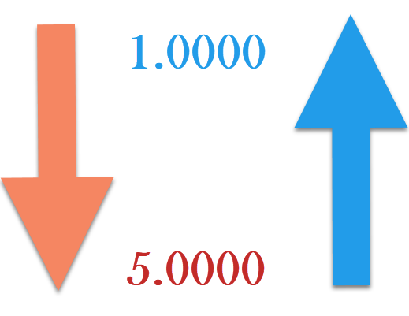

Slide 4
POINT(S)
GRADE | POINT(S)
A | 1
B | 2
C | 3
D | 4
F | 5
DIVISION | POINT(S)
I | 1
II | 2
III | 3
IV | 4
0 | 5

Slide 5
STUDENT GPA
A=1, B=2, C=3, D=4, F=5
(#As) + (#Bs*2) + (#Cs*3) + (#Ds*4) + (#Fs*5)
Number Of All Students’ Subjects

Slide 6
SUBJECT GPA
A=1, B=2, C=3, D=4, F=5
(#As) + (#Bs*2) + (#Cs*3) + (#Ds*4) + (#Fs*5)
Number Of All Students Involved

Slide 7
SCHOOL GPA
A=1, B=2, C=3, D=4, F=5
DivI=1, DivII=2, DivIII=3, DivIV=4, Div0=5
Division GPA = (#DivI)+(#DivII*2)+(#DivIII*3)+(#DivIV*4)+(#Div0*5)
Number Of All Students Involved
Subjects GPA = (#As) + (#Bs*2) + (#Cs*3) + (#Ds*4) + (#Fs*5)
Number Of All Grades Involved
School GPA = Division GPA + Subjects GPA
2

Slide 8
COMPENTENCY LEVEL
SN | GPA RANGES | GRADE & REMARK | COLOR
1 | 1.0000 – 1.5999 | Grade A (Excellent)
2 | 1.6000 – 2.5999 | Grade B (Very Good)
3 | 2.6000 – 3.5999 | Grade C (Good)
4 | 3.6000 – 4.5999 | Grade D (Satisfactory)
5 | 4.6000 – 5.0000 | Grade F (Fail)

Slide 9
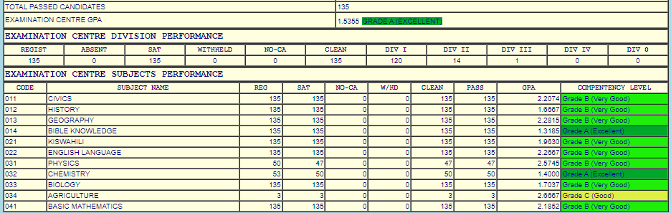

Slide 10
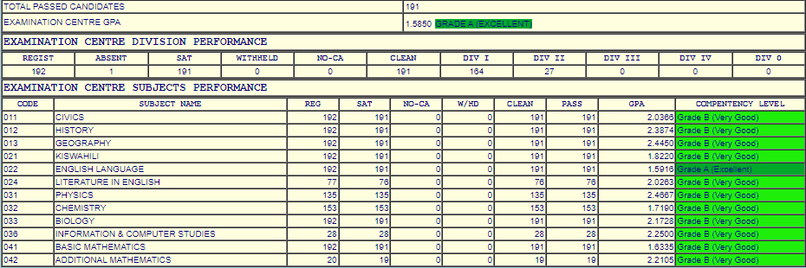

Slide 11
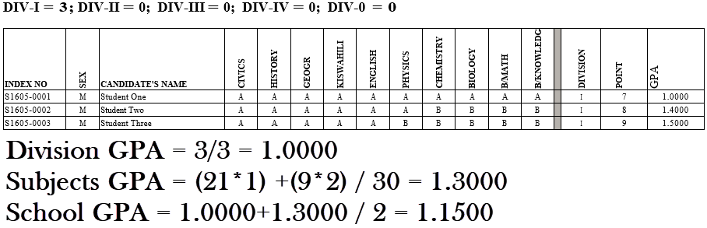
EXAMPLE #1

Slide 12
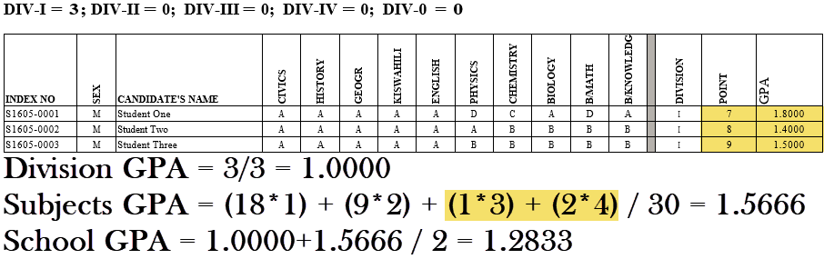
EXAMPLE #2

Slide 13
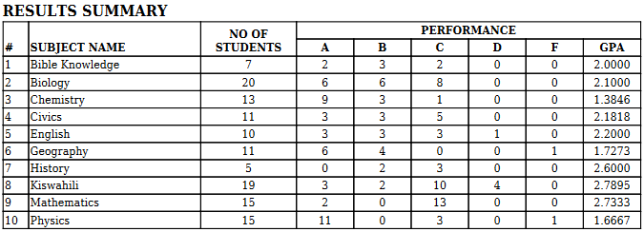
EXAMPLE #3

Slide 14
CONTACTs:
0753 11 95 26
0655 53 36 56
KELVIN FUSSI

Slide 15
ASANTENI SANA

