Slide 1
EVANGELICAL LUTHERAN CHURCH TANZANIA
COASTAL DIOCESE
JERUSALEM PRE AND PRIMARY SCHOOL KIMARA

Slide 2
1.0 Background
Jerusalem Pre and Primary School is located in Dar es Salaam at Kimara Korogwe. It belongs to the Evangelical Lutheran Church of Tanzania (ELCT) and managed by Kimara Korogwe Parish. Our school was established in 15th Jan 2018.
VISION “To partner with parents to provide a strong educational and spiritual development for each individual child so that they live, love, learn and leave a legacy”
MISSION “To pursue excellence for Christ by developing God-given gifts and using them in His service”
MOTTO: Academic and Moral Excellence

Slide 3
Our school Plan
Creating modern school with distinctive Christianity perspective.
Create life long learners
Improving quality of education and performance at national examinations
Creating a modern school that will attract and retain both staff and learners.

Slide 4
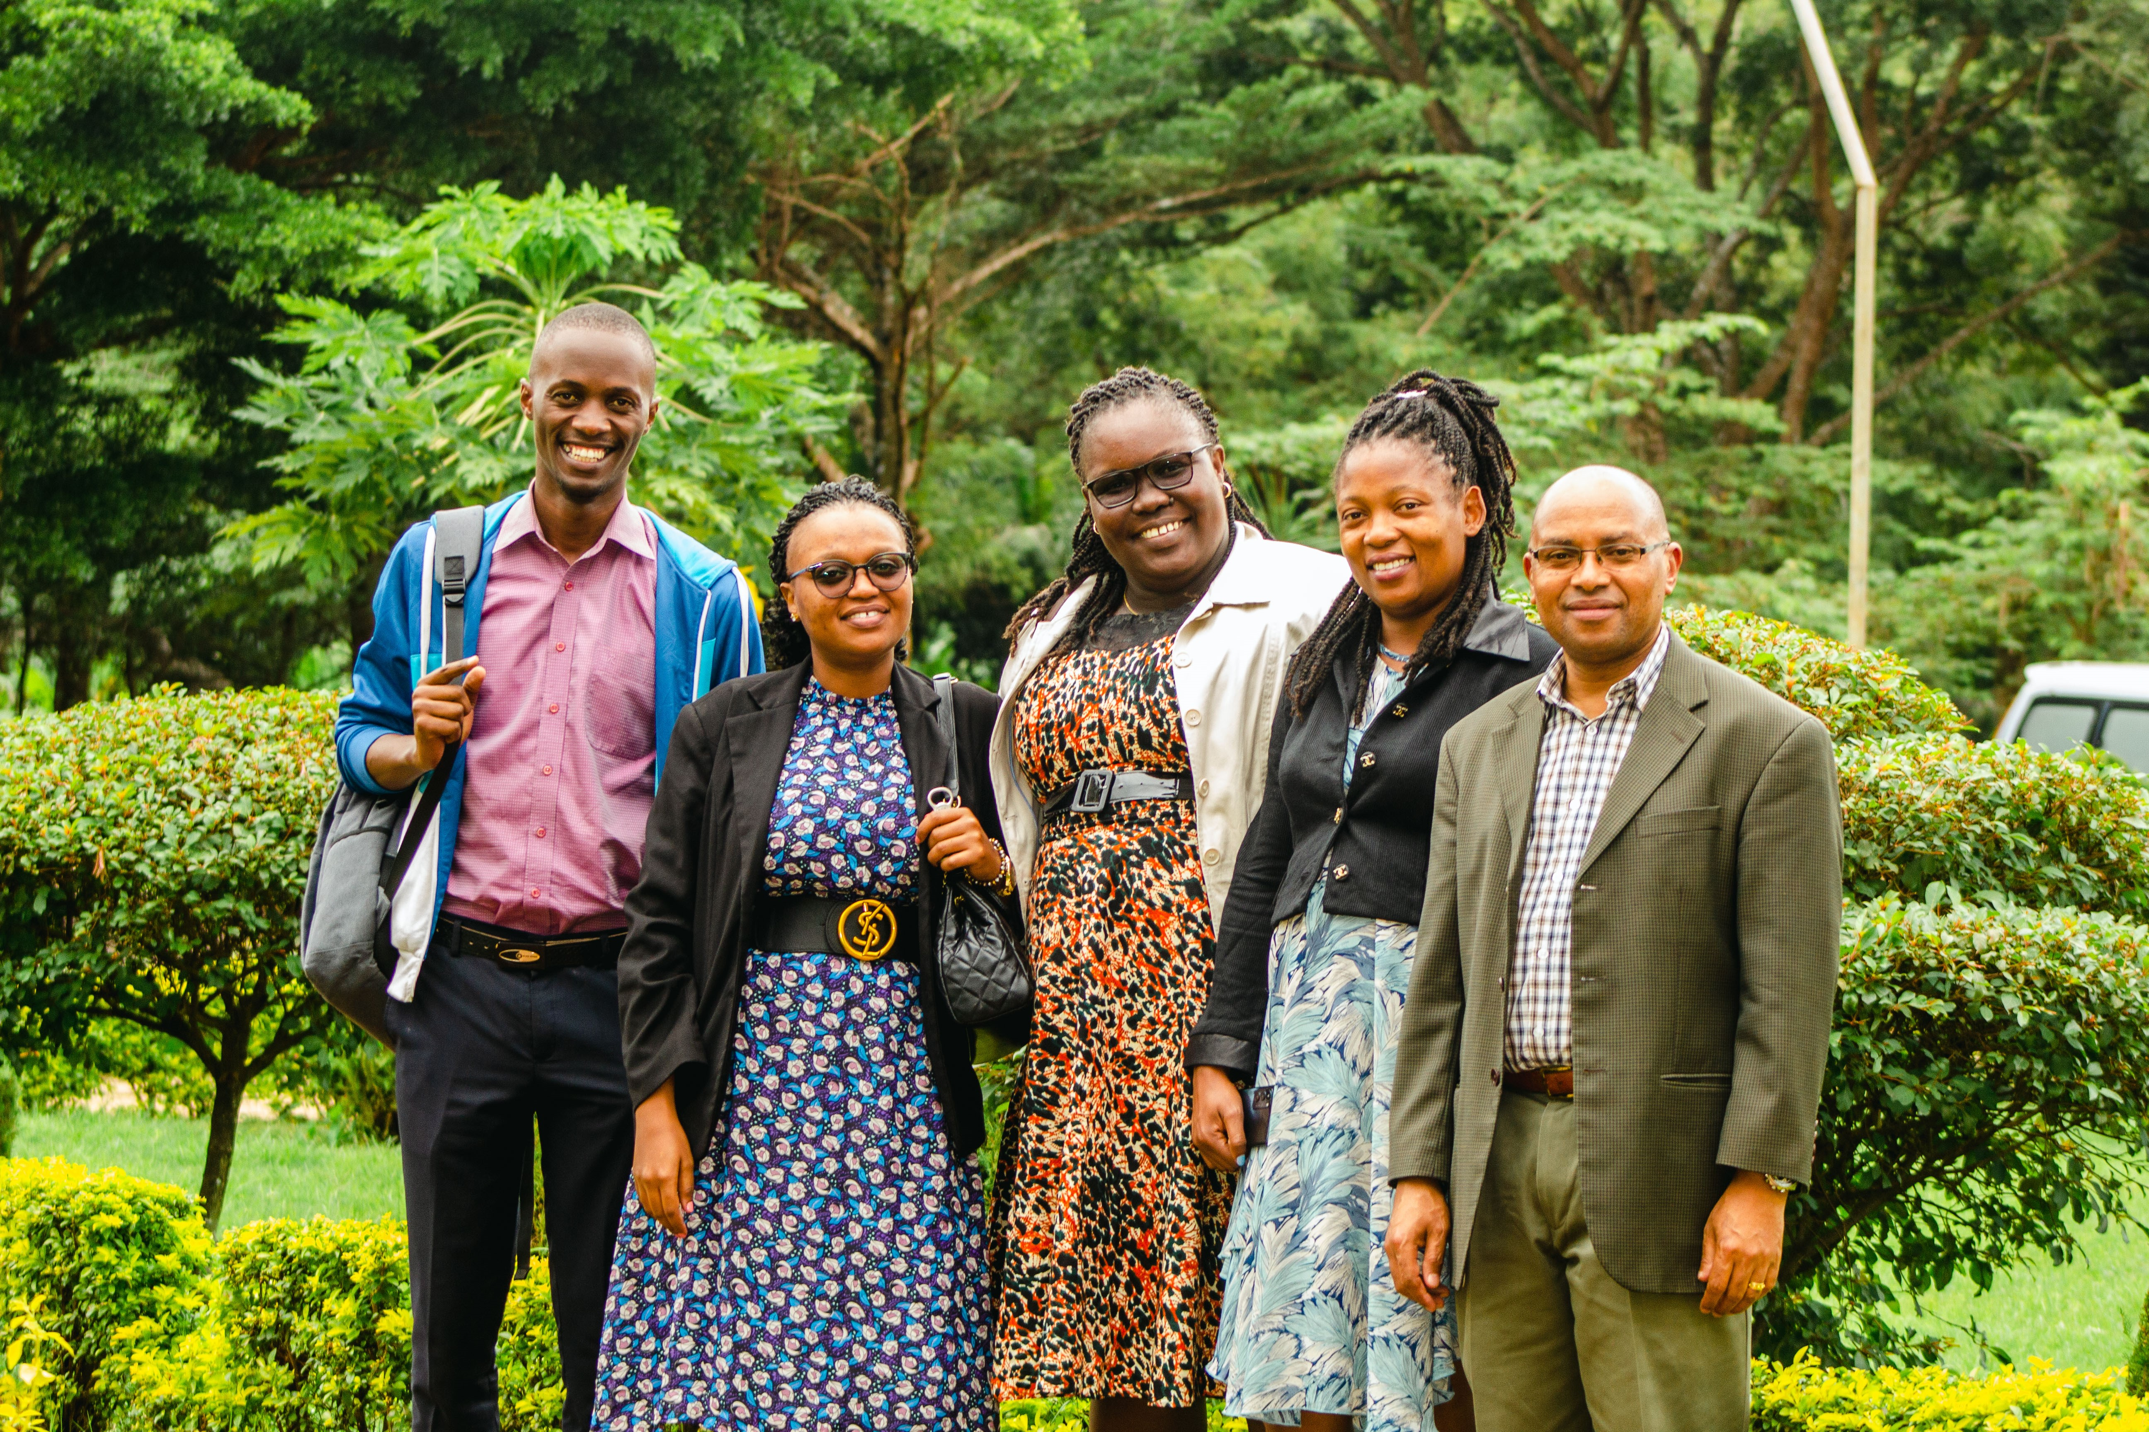
Our Core Values
Trust
Responsibility
Respect
Collaboration
Accountability

Slide 5
Enrollment
The school started with 106 learners in Pre school and 111 learners in Primary Grade 1 and 2
Currently we have a total of 1,326 and learners, 359 learners in Pre School and 967 learners in Primary school with Grade 1 – 7 to date.
We provide education to orphans 38 from the church children’s home and 15 children living in challenging conditions in the community surrounding our school

Slide 6
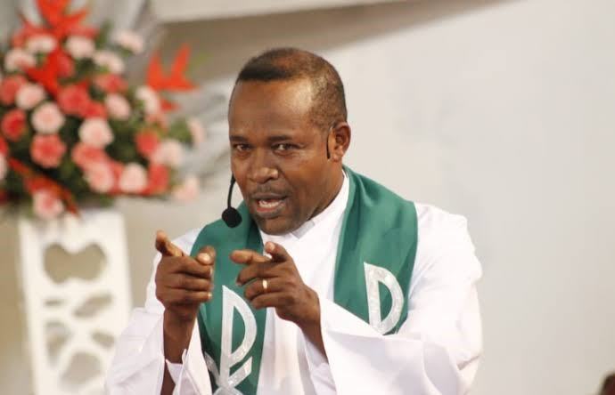
Spiritual services
Opening and closing school service
Staff morning service
Weekly church service lead by Learners
Class wise church service twice a year
Spiritual services for both learner and parent
Staff church services every quarter
Pupils praise and worship choir
Staff choir
The whole school community attends these spiritual services

Slide 7
JERUSALEM MORAL VALUES
Through church services, moral values of our school work alongside with the school motto (Academic and Moral excellence) Pupils are expected to demonstrate these morals everywhere and every time in there life.
Integrity: I tell the truth.
Confidence: I can try and do many things with out fear.
Respect: Respect yourself and everyone else.
Creativity: I have many different ways of doing things.
Curiosity: I want to know more about the world.
Appreciation: I am thankful for the wonders of the world.
Caring: Caring is sharing.
Thinker: I use my power of mind to understand.
Risk Taker:I always do what I cannot do so that I can learn.
Communicator: I share my Ideas with others.
Responsibility: I choose the right thing to do in the right time.
Trust: I cannot do anything without

Slide 8
CURRICULUM AND ACADEMICS
Our School is registered under the Tanzanian Ministry of Education Science and Technology and follows the National Examination Council of Tanzania (NECTA) curriculum in both Pre and Primary with registration no EM 72363.
Teaching and learning activities are practiced both theoretically and Practically.
Being a church school we offer Moral and spiritual service and support to all stakeholders
The overall performance of pupils has been very good.
Out of 60 grade seven candidates 35 attained “A” and 25 attained “B”

Slide 9
Extra curriculum
In Jerusalem every child's given gifts and dreams matters and cherished.
Our school co ordinates sports, games and clubs for all pupils, Clubs are chosen depending on the child’s talent and hobbies.
Foreign languages taught are German and French
Theoretic and practical music
ICT
Field trips to emphasis what is taught in class making learning interesting and fun

Slide 10
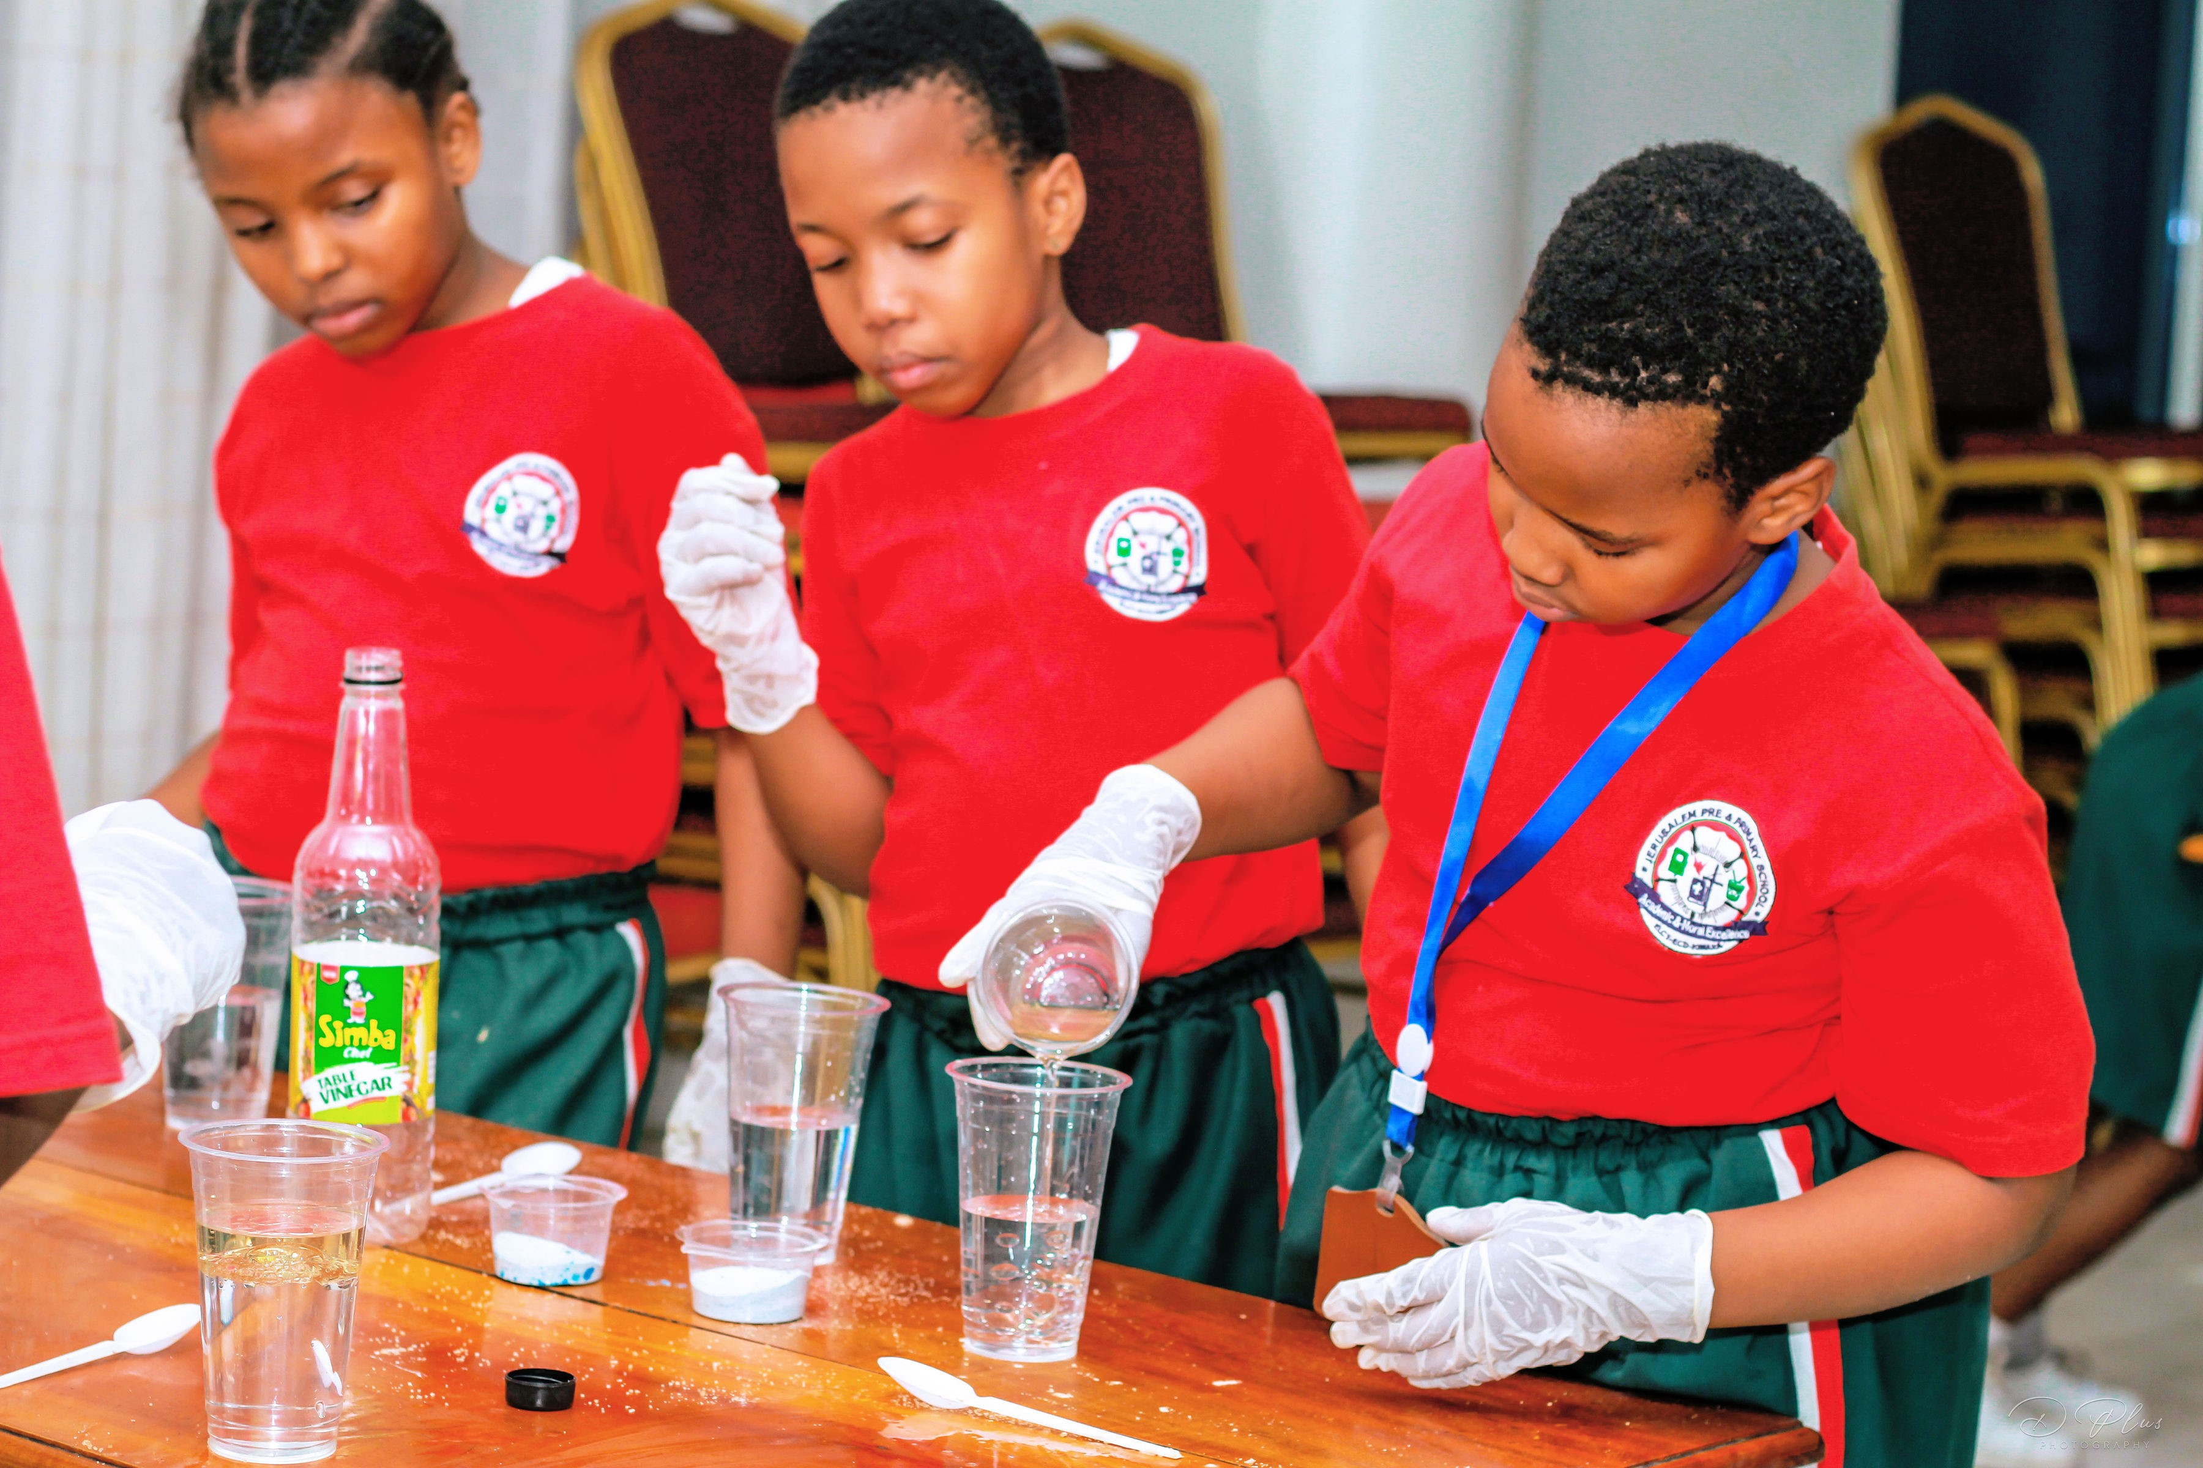
Managing academics
Head of departments work effectively
Spiritual services through church
Interna quality assures /Team leaders
Good staff management and retainment
Morning bulleting
Weekly meetings
Exam Analysis
Practical learning
Panel marking
Eternal exams
Table teaching
Inclusive learning
Teacher Mentorship for grade 7 pupils

Slide 12
Other Services
Spiritual support through church services and prayers for learners, staff, parents and community at large
Guidance and counselling
First aid department
Transport
Runshule data base service
Food (Breakfast and Lunch)
Clean and safe water
Electricity

Slide 13
Quality of our service depends on
Credence
Government policies
Institution policies
Professionalism
Appearance
Performance
Accountability
Collaboration
Dignity
Ethics
Open minded

Slide 14
Impact of our service
Customers are loyal and own the institution
Parents give quick feedback
ownership
Customers easily recommend others
Growth
More income
Better learning environment
Better working environment
Personal growth for all staff
Staff retention

Slide 15
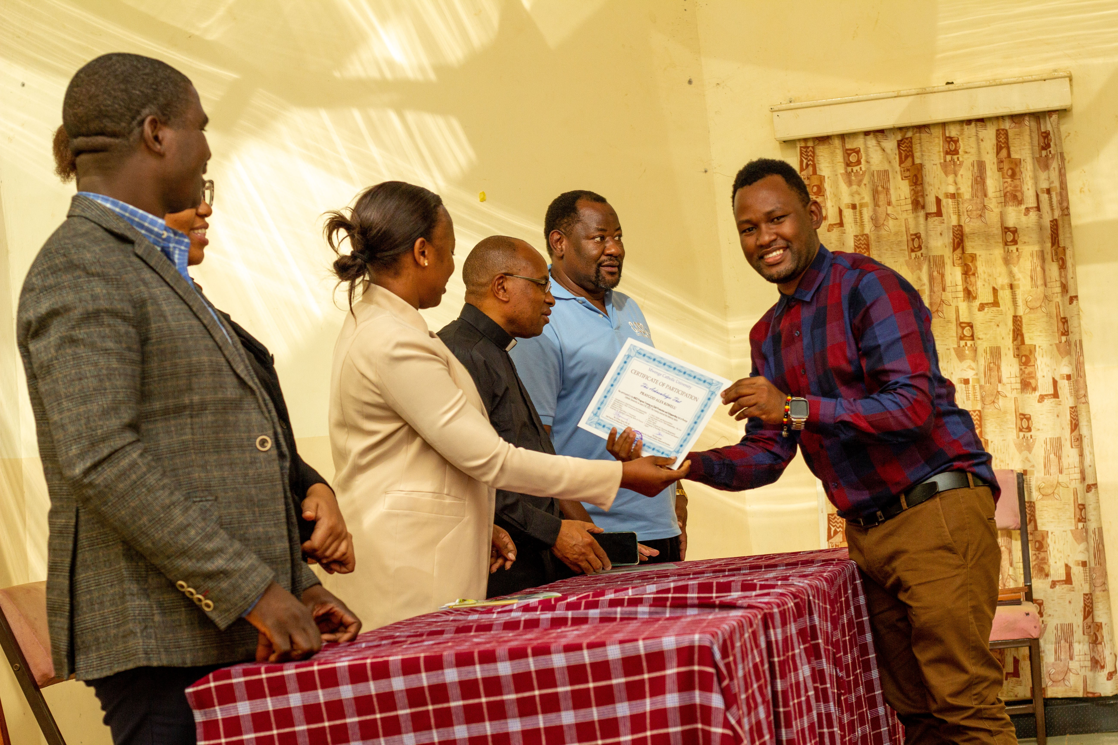
Staff retention strategy
Long term contracts for hard working staff
Great working environment
Good salaries
Staff seminars and development
Full Sponsorship offer for one child of every teacher
Spiritual services for all staff
Social Welfare community
Vikoba
Personal Bank loans through our church Bank

Slide 16
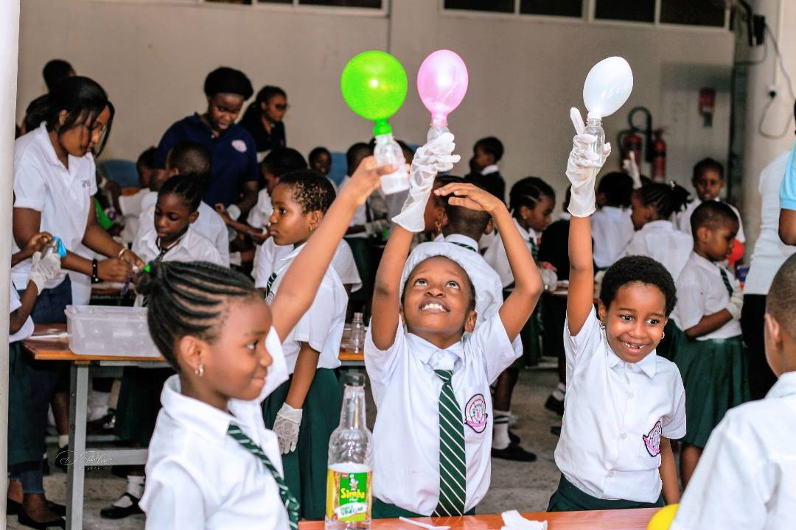
PRACTICAL LEARNING
There are so many ways of learning but practical learning benefits most learners
Clubs
Sports
Theory
Practical
Field trips
Presentations
Relating to real life
Talents
Inclusive class
Visual

Slide 17
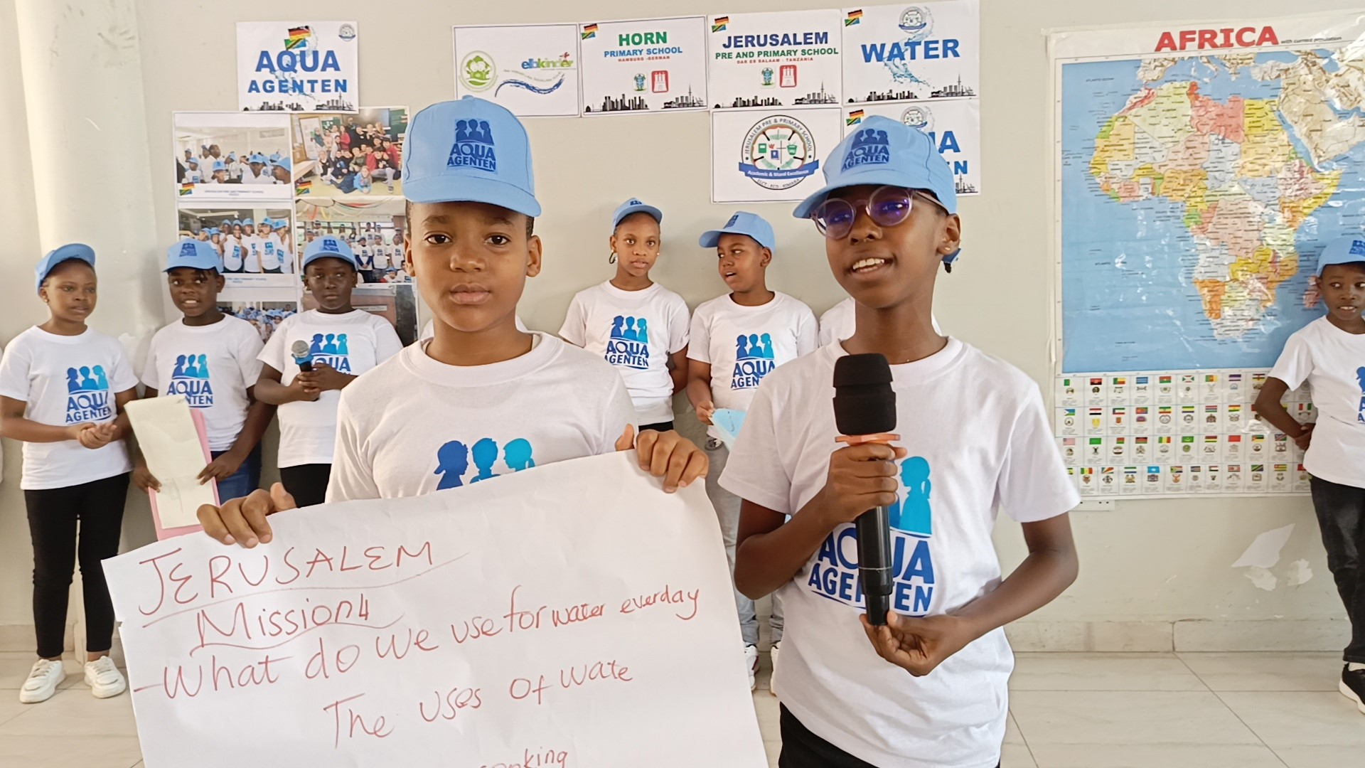
Benefit of Practical learning
Improves skills
Increases understanding
Deeper impact
Teachers know their leaners better
Retains knowledge
Discourages memorization
Learners will love learning
Deals with real life
Thinkers
Risk takers
Learning is fun and interesting
Teachers are learners

Slide 18
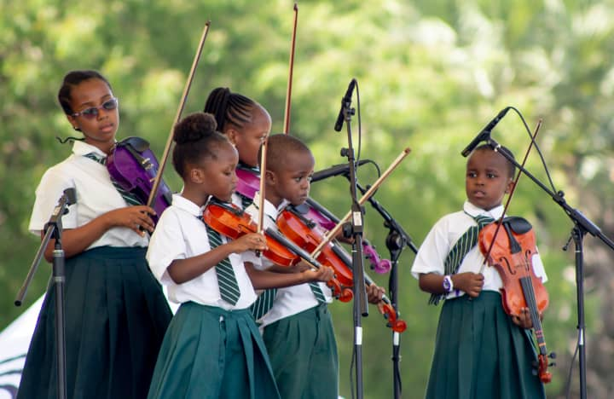
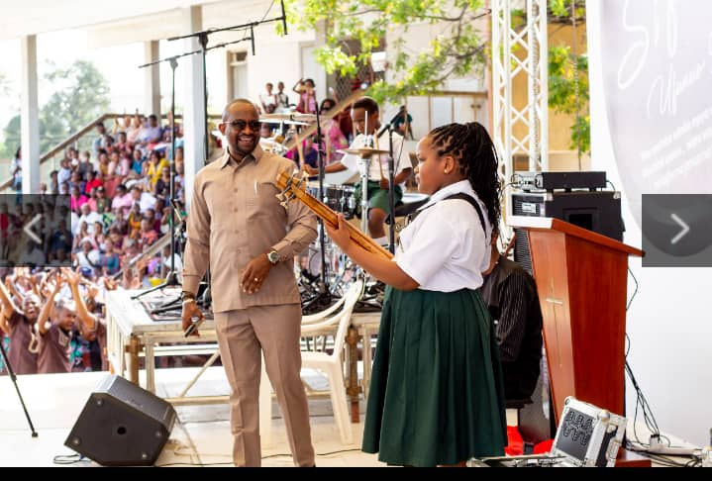
Music

Slide 19
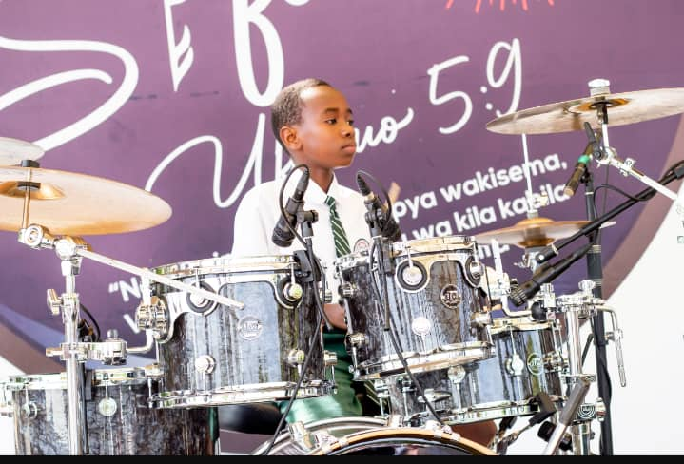
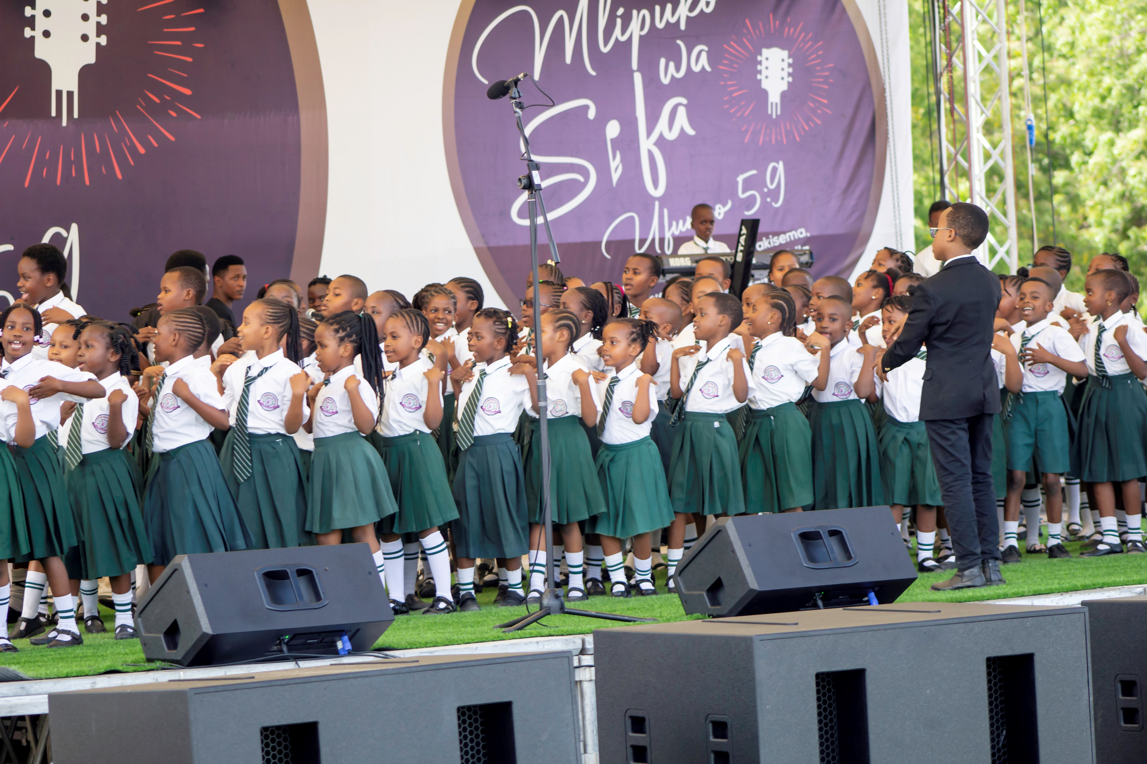

Slide 20
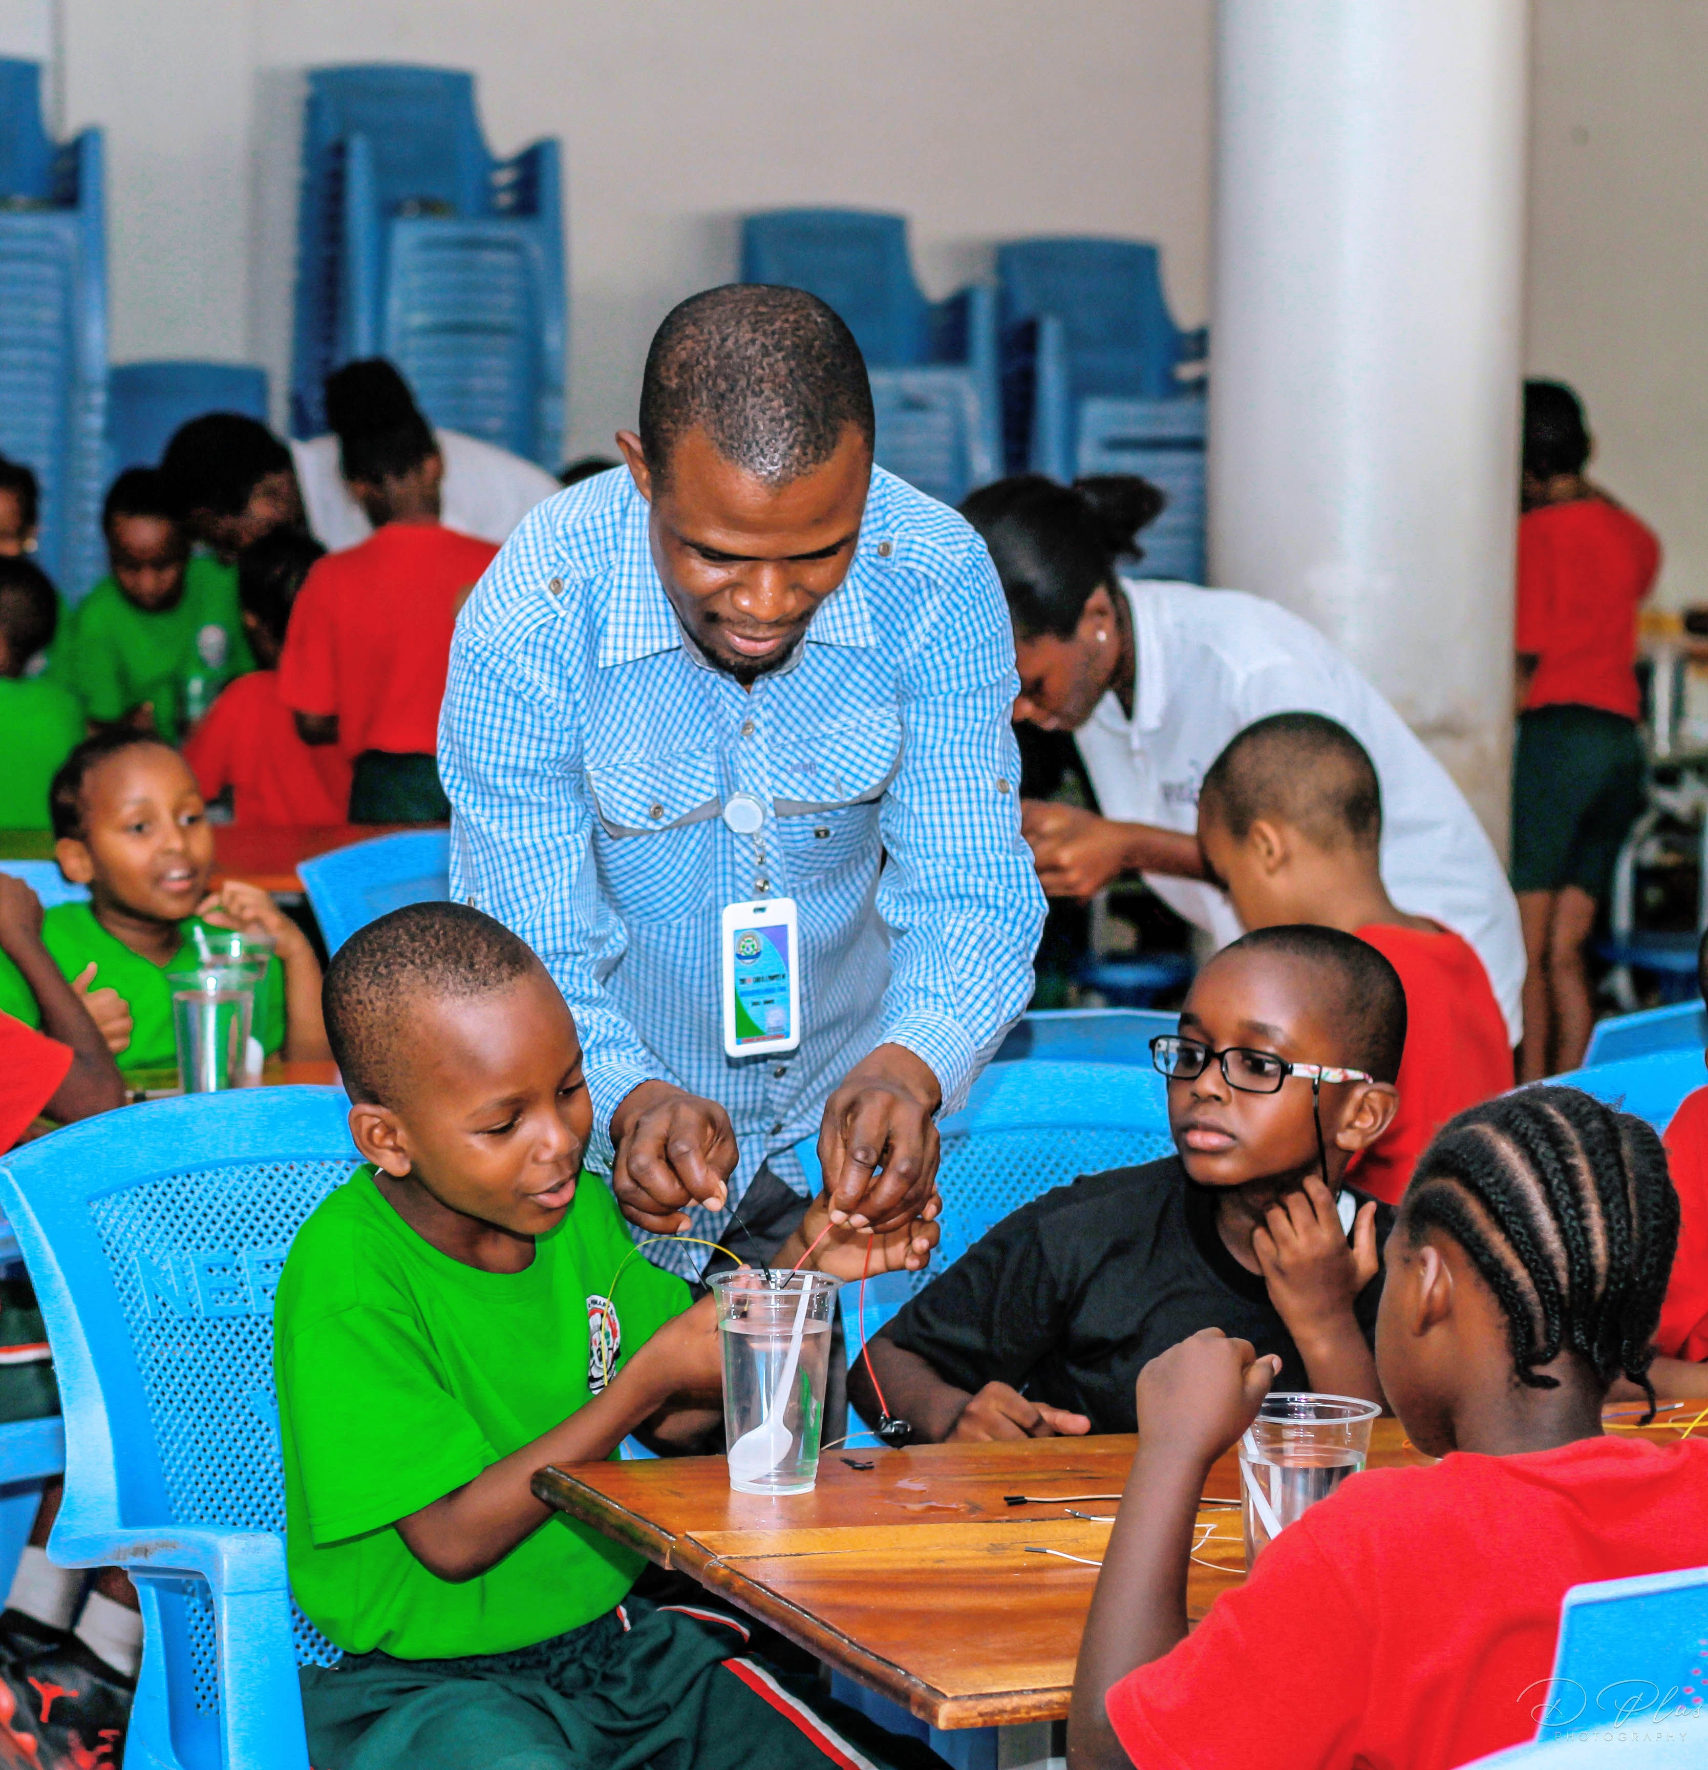
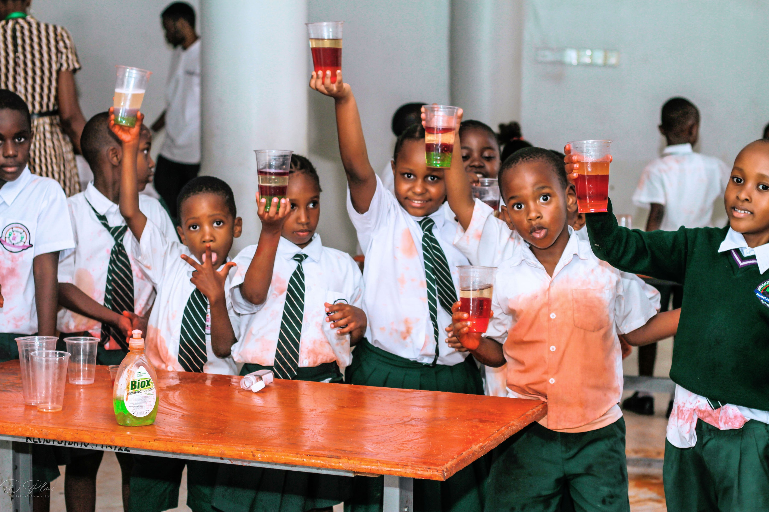
EXPERIMENTS

Slide 21
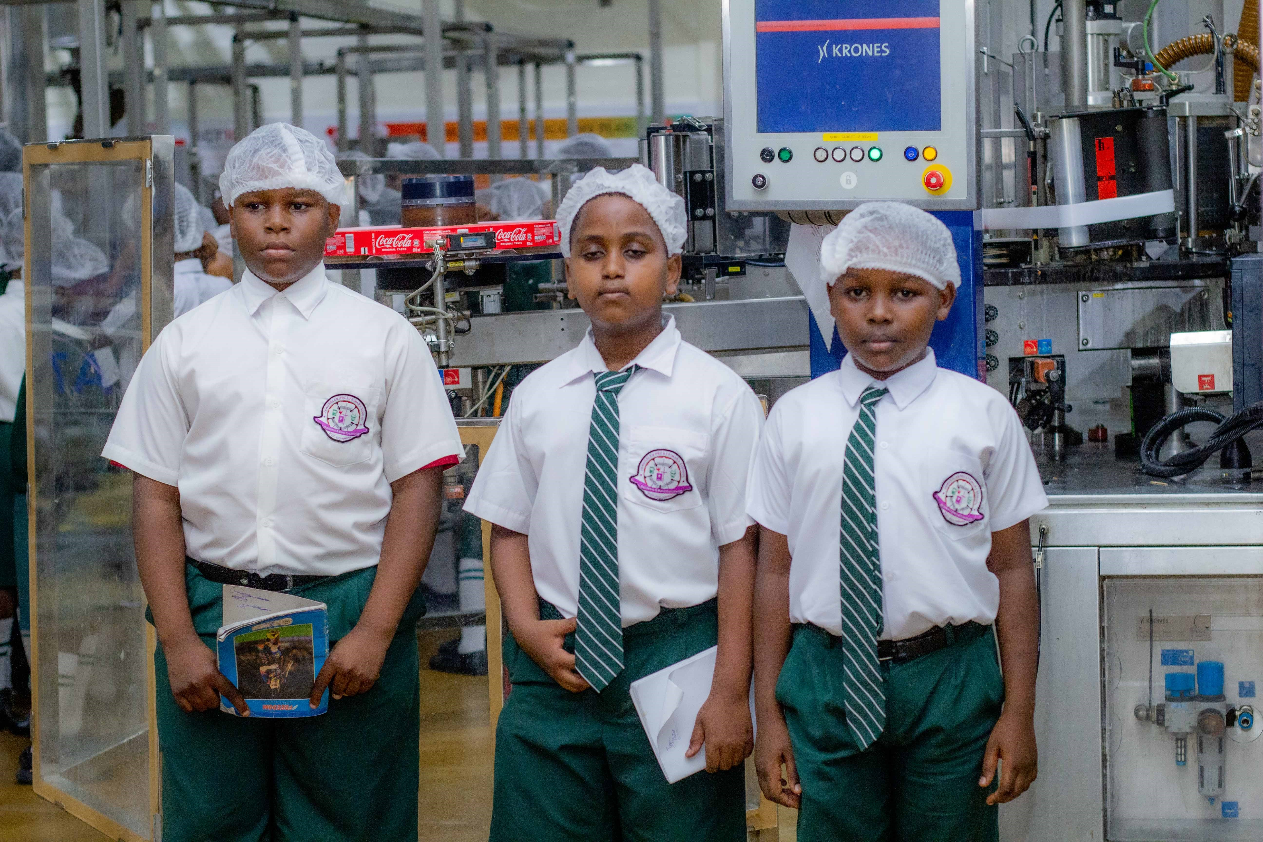
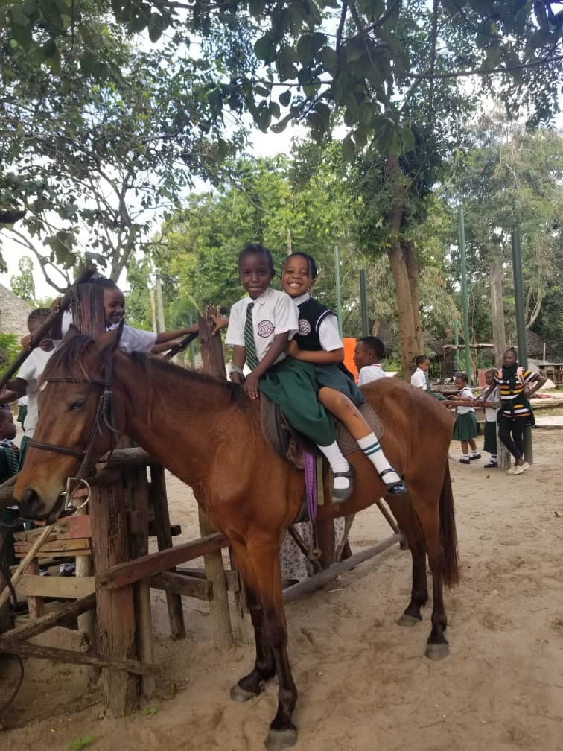
FIELD TRIPS

Slide 22
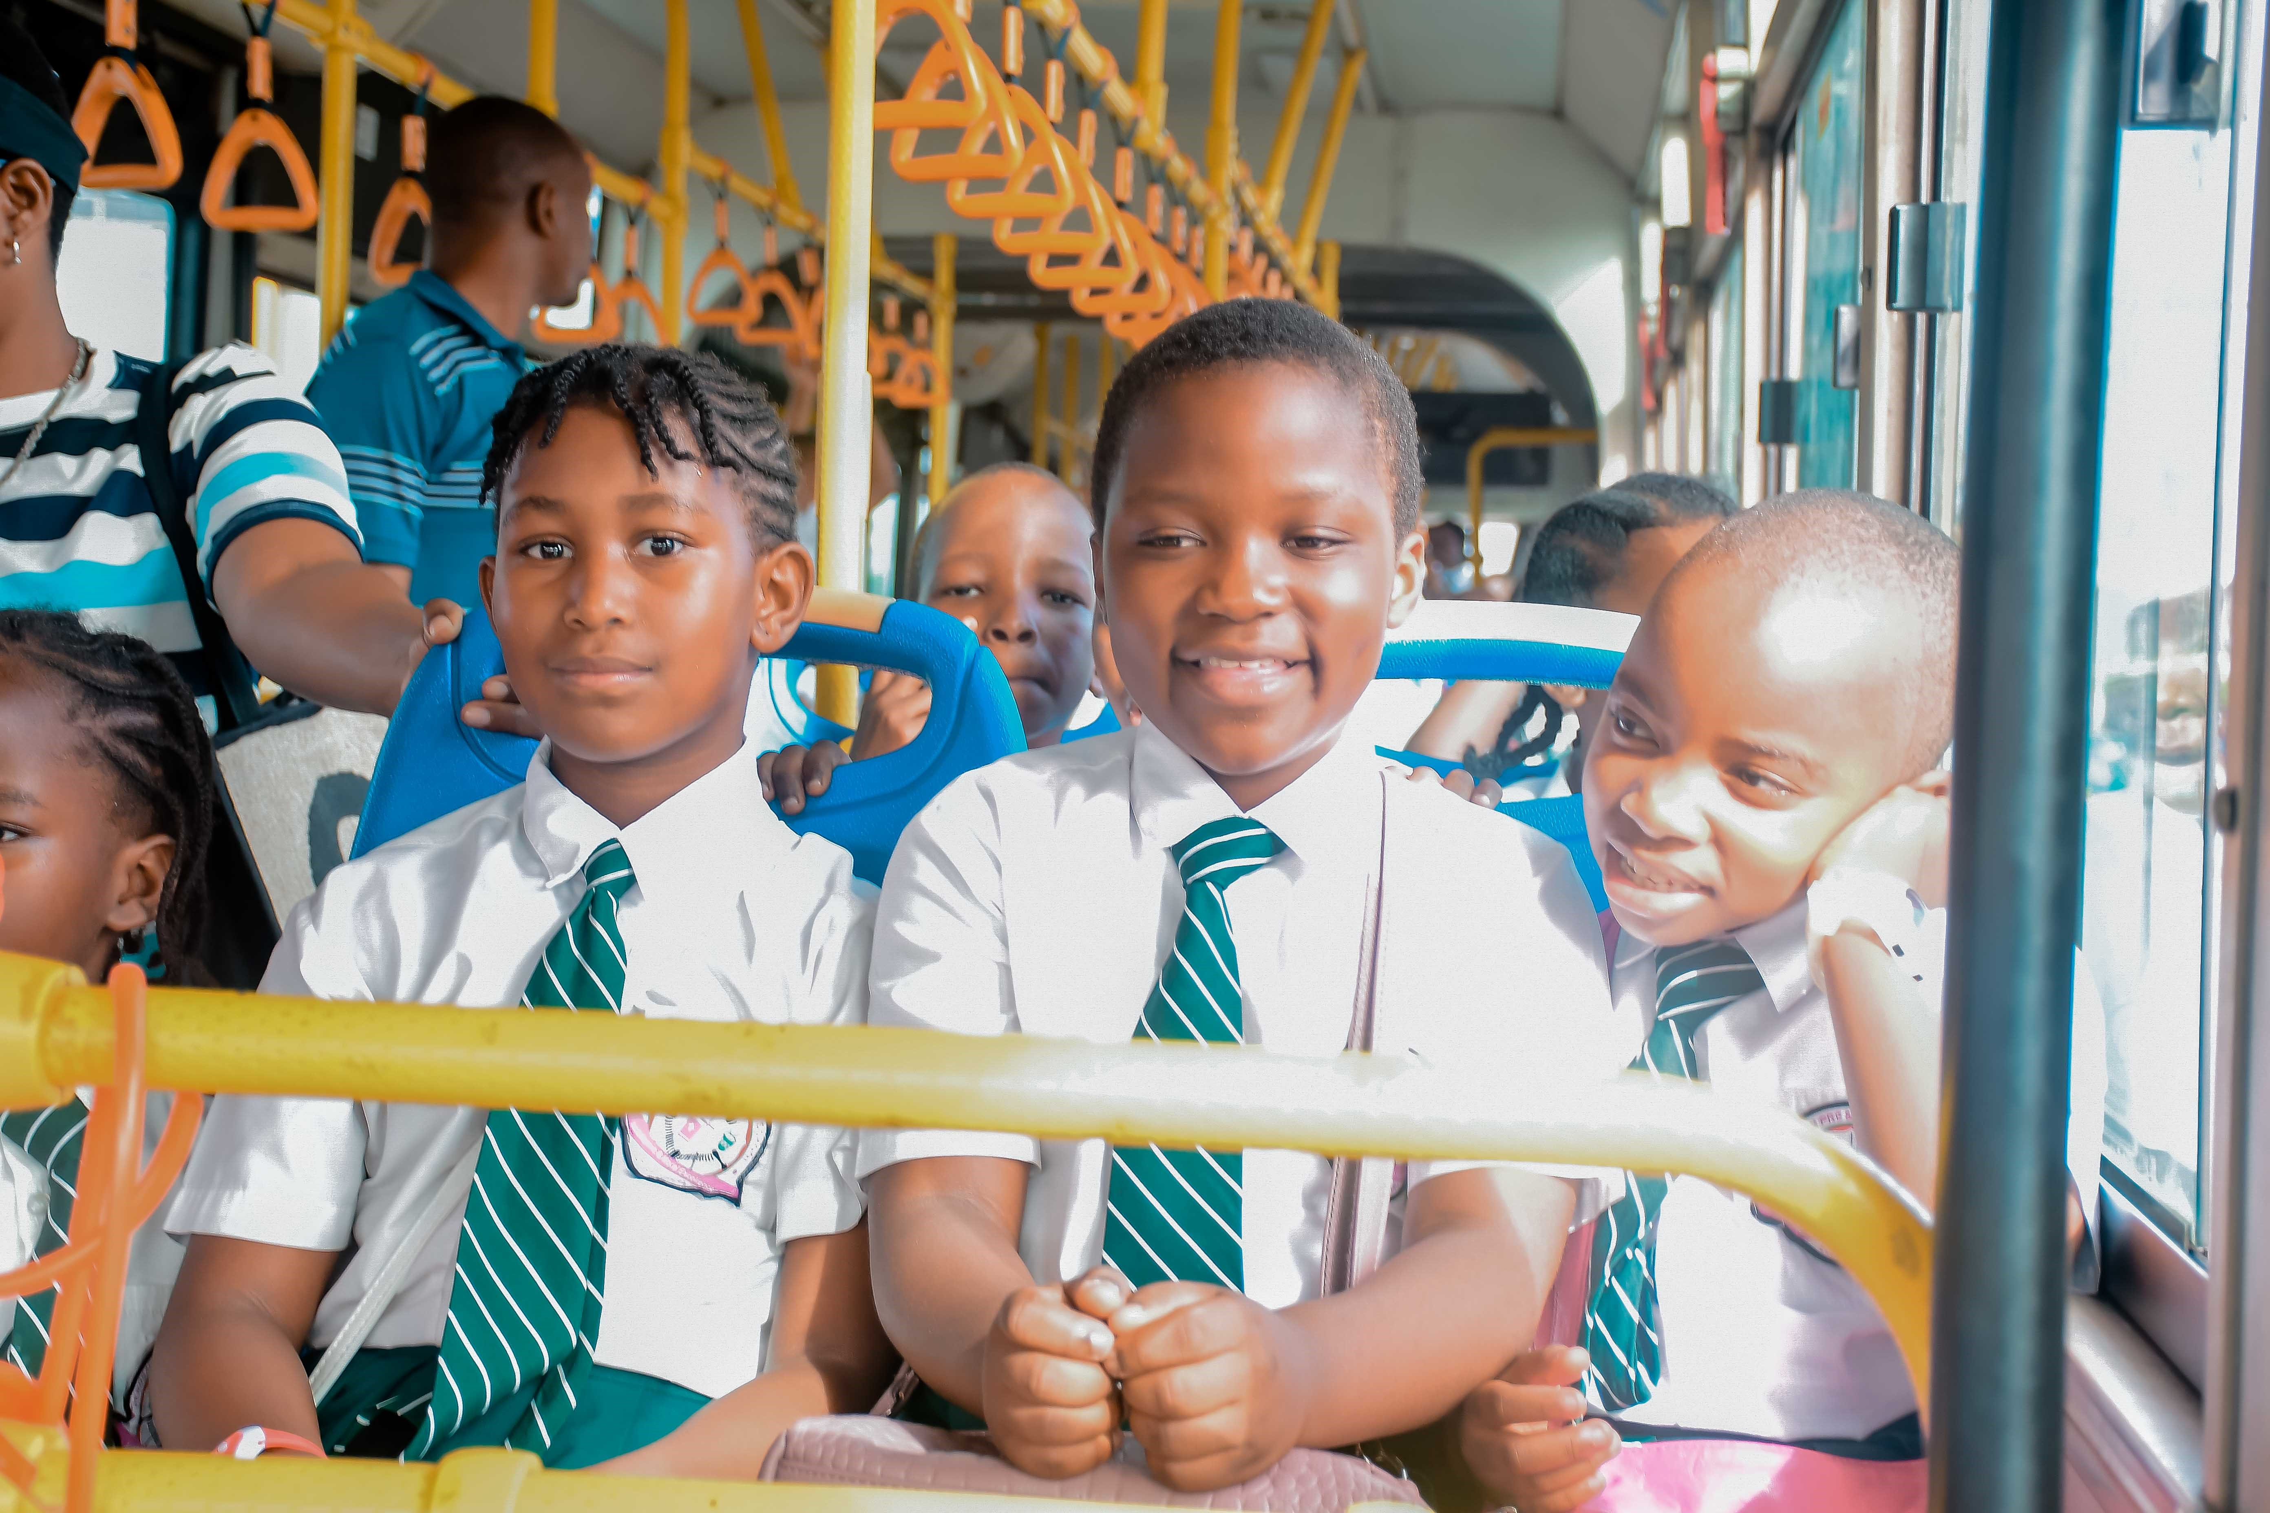
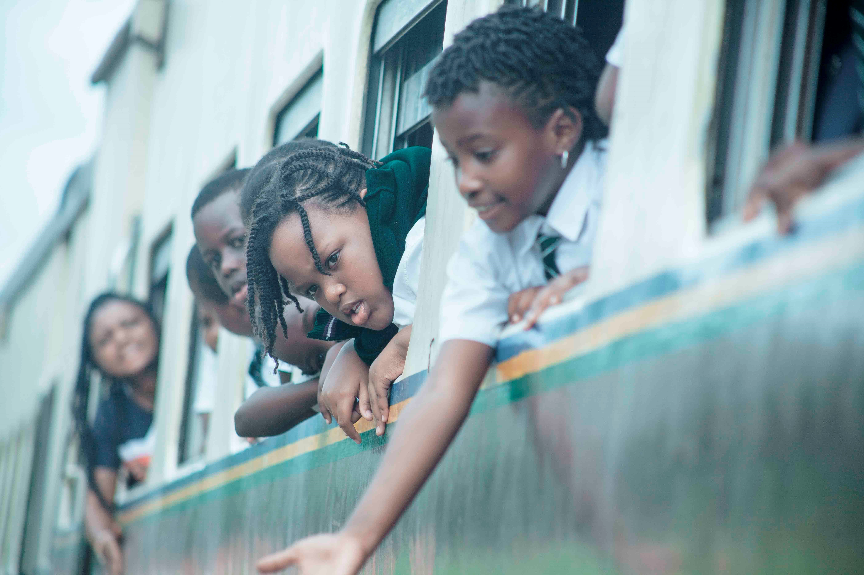

Slide 23
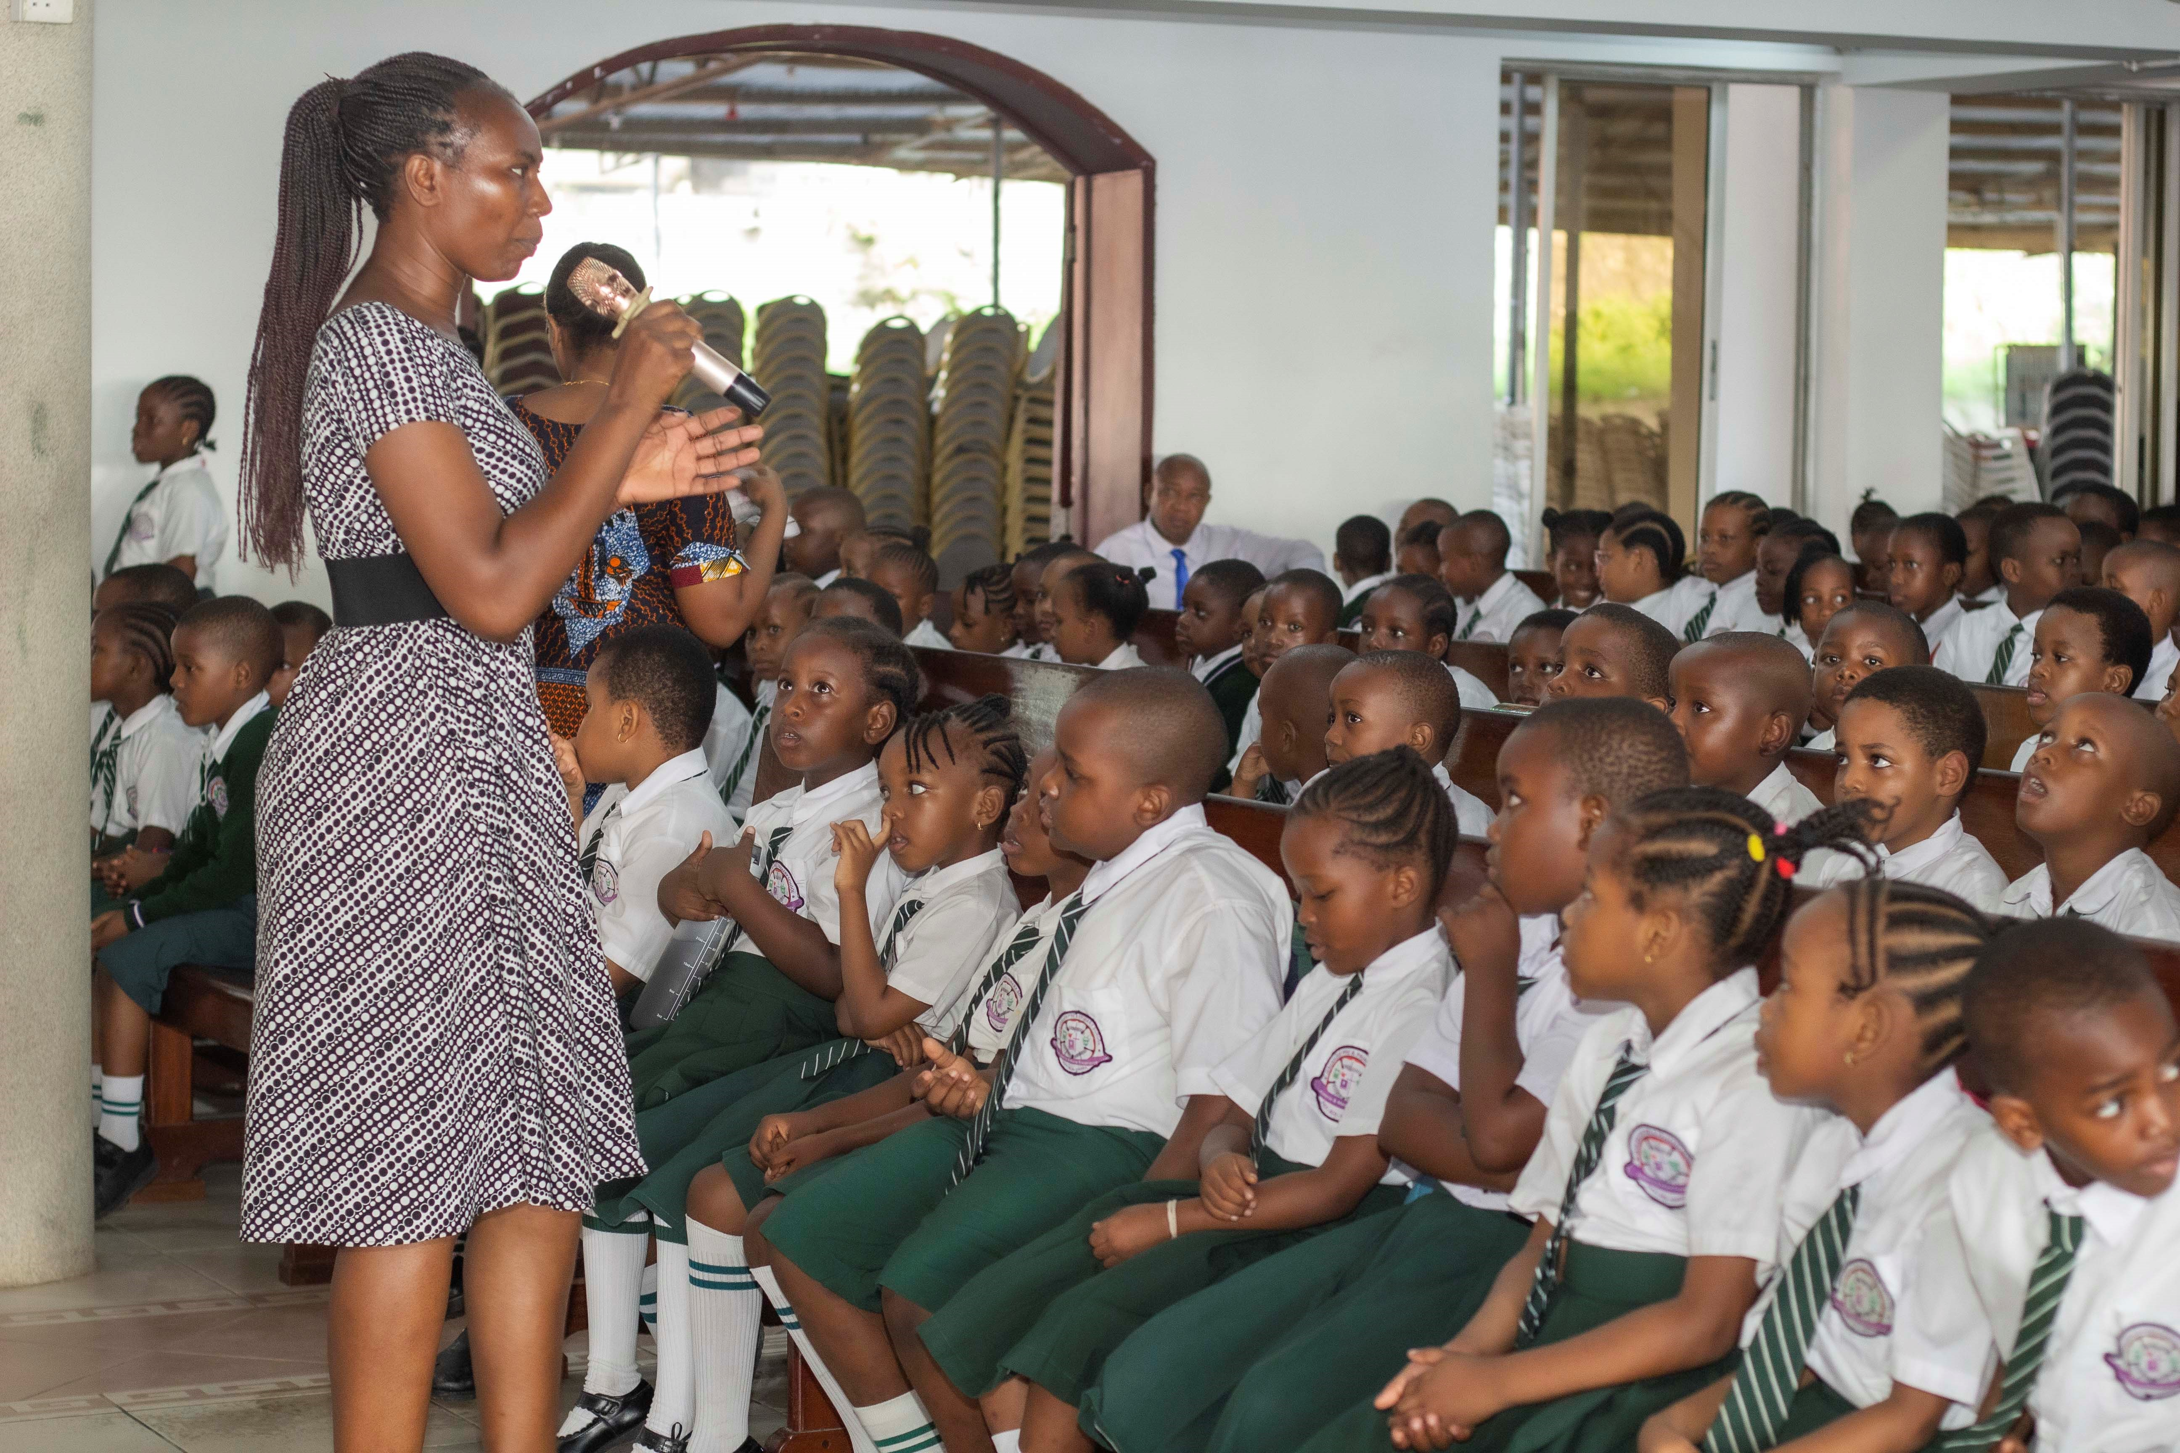
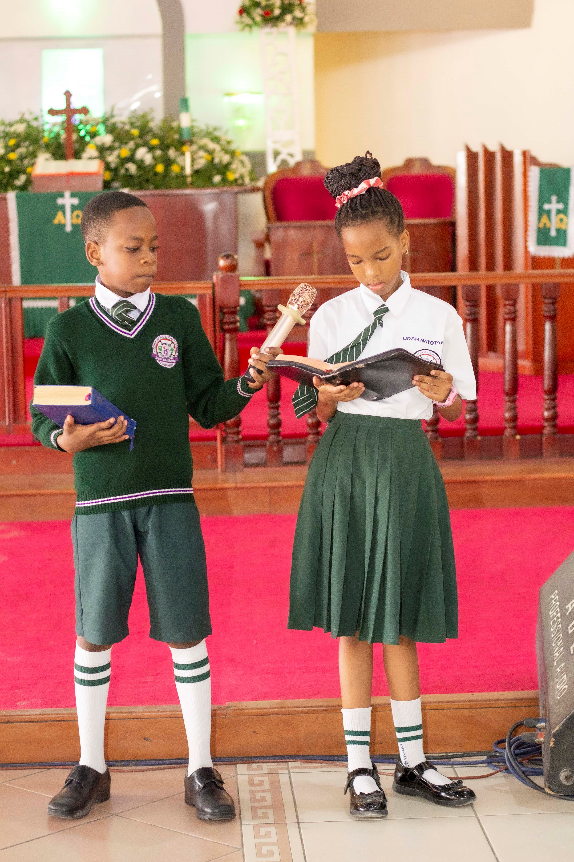
CHURCH SERVICES

Slide 24
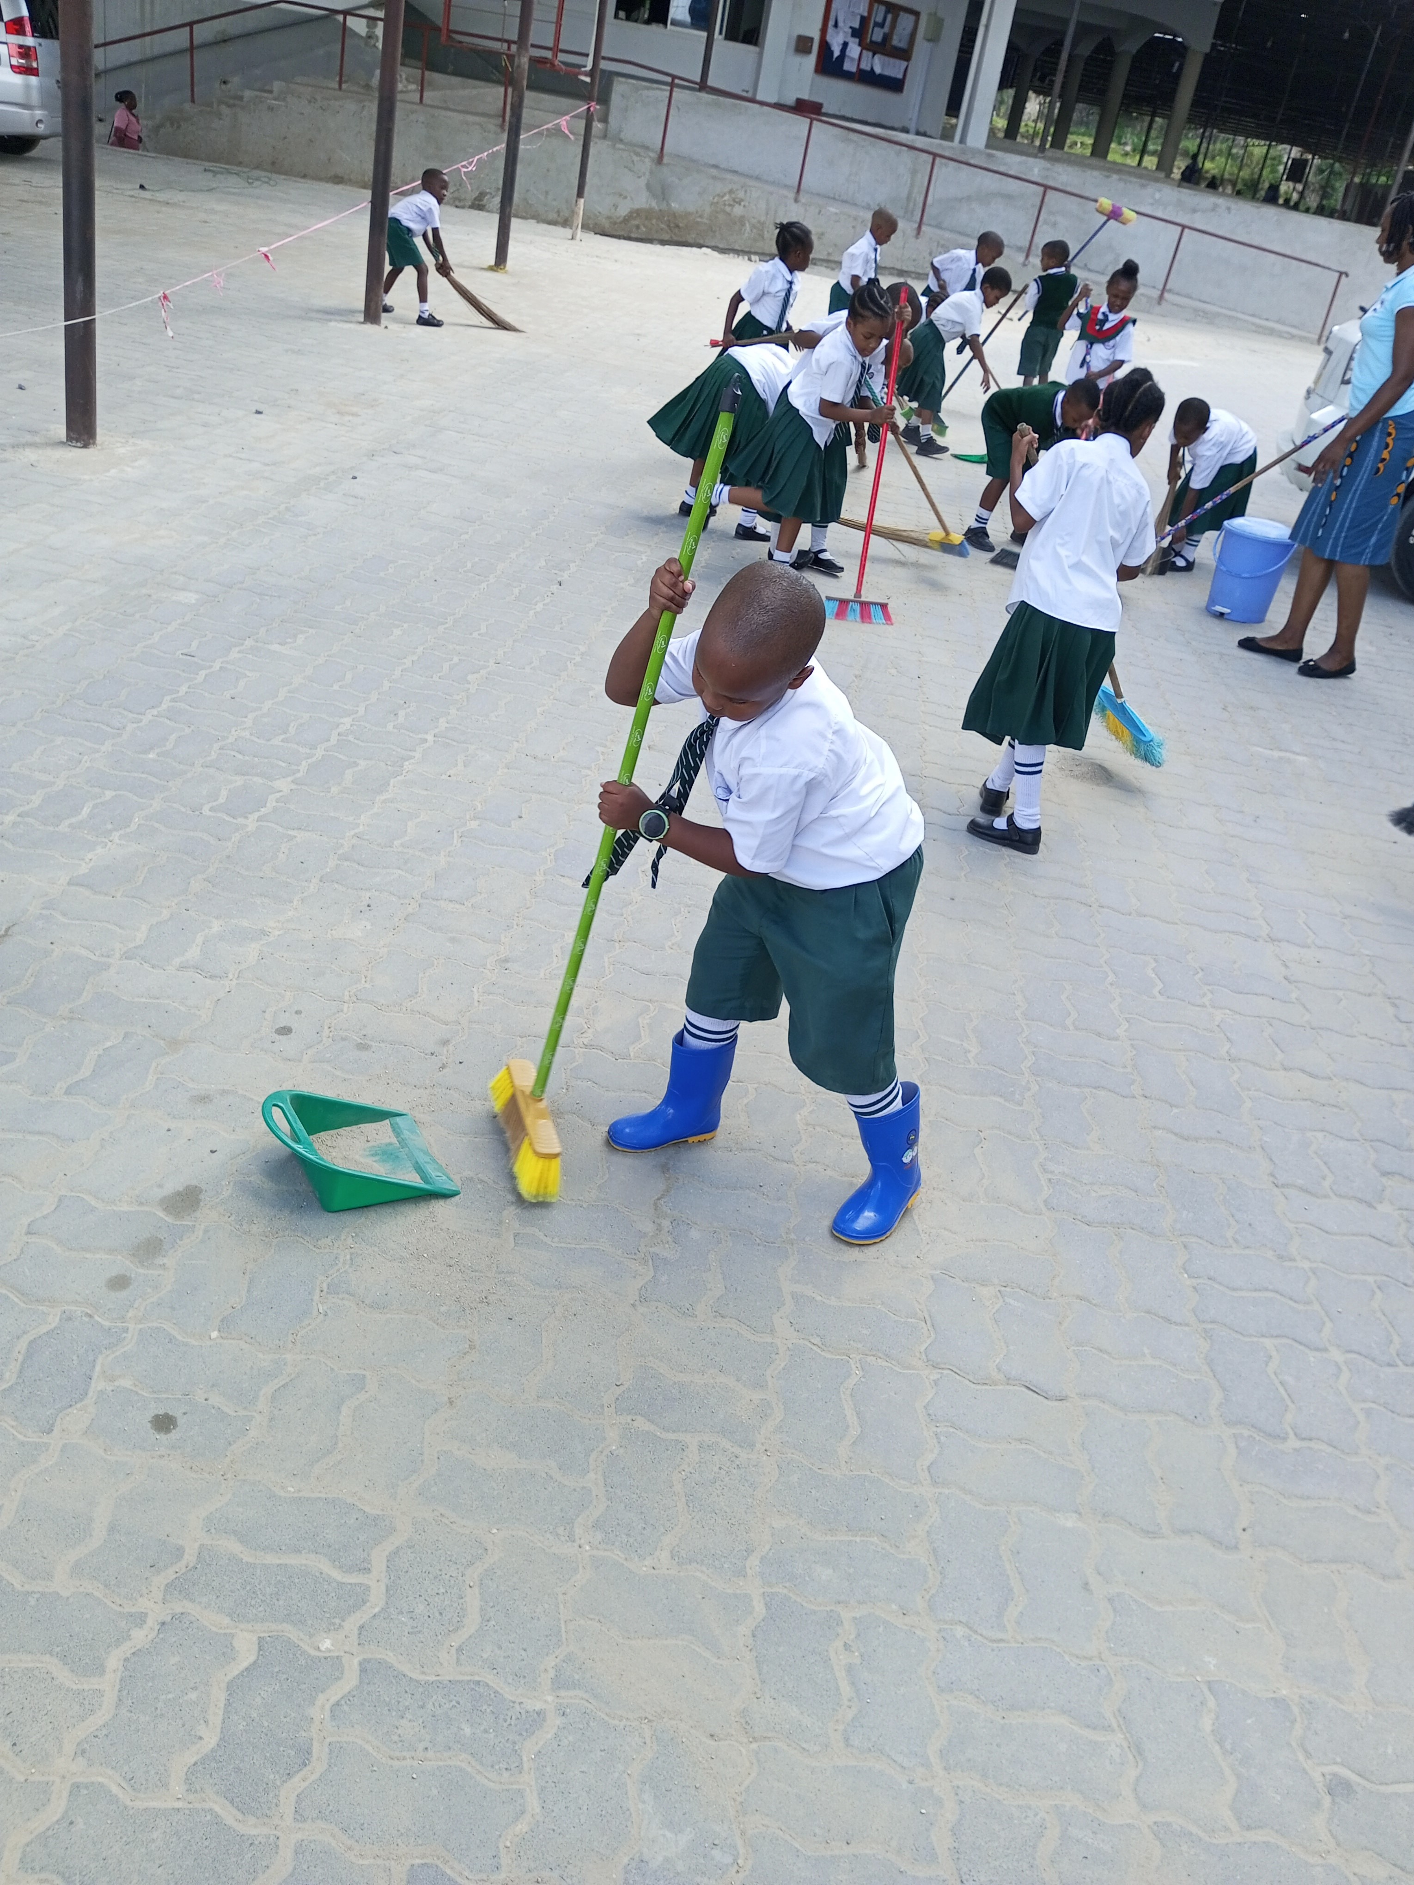
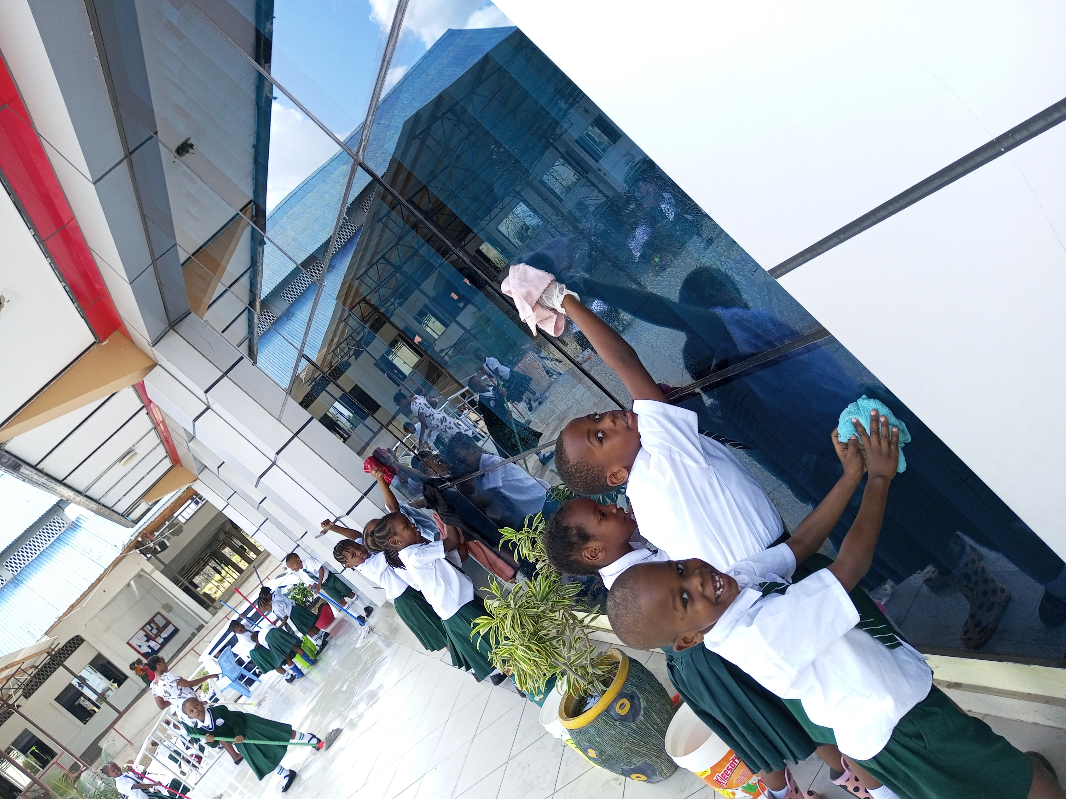
CLEANING

Slide 25
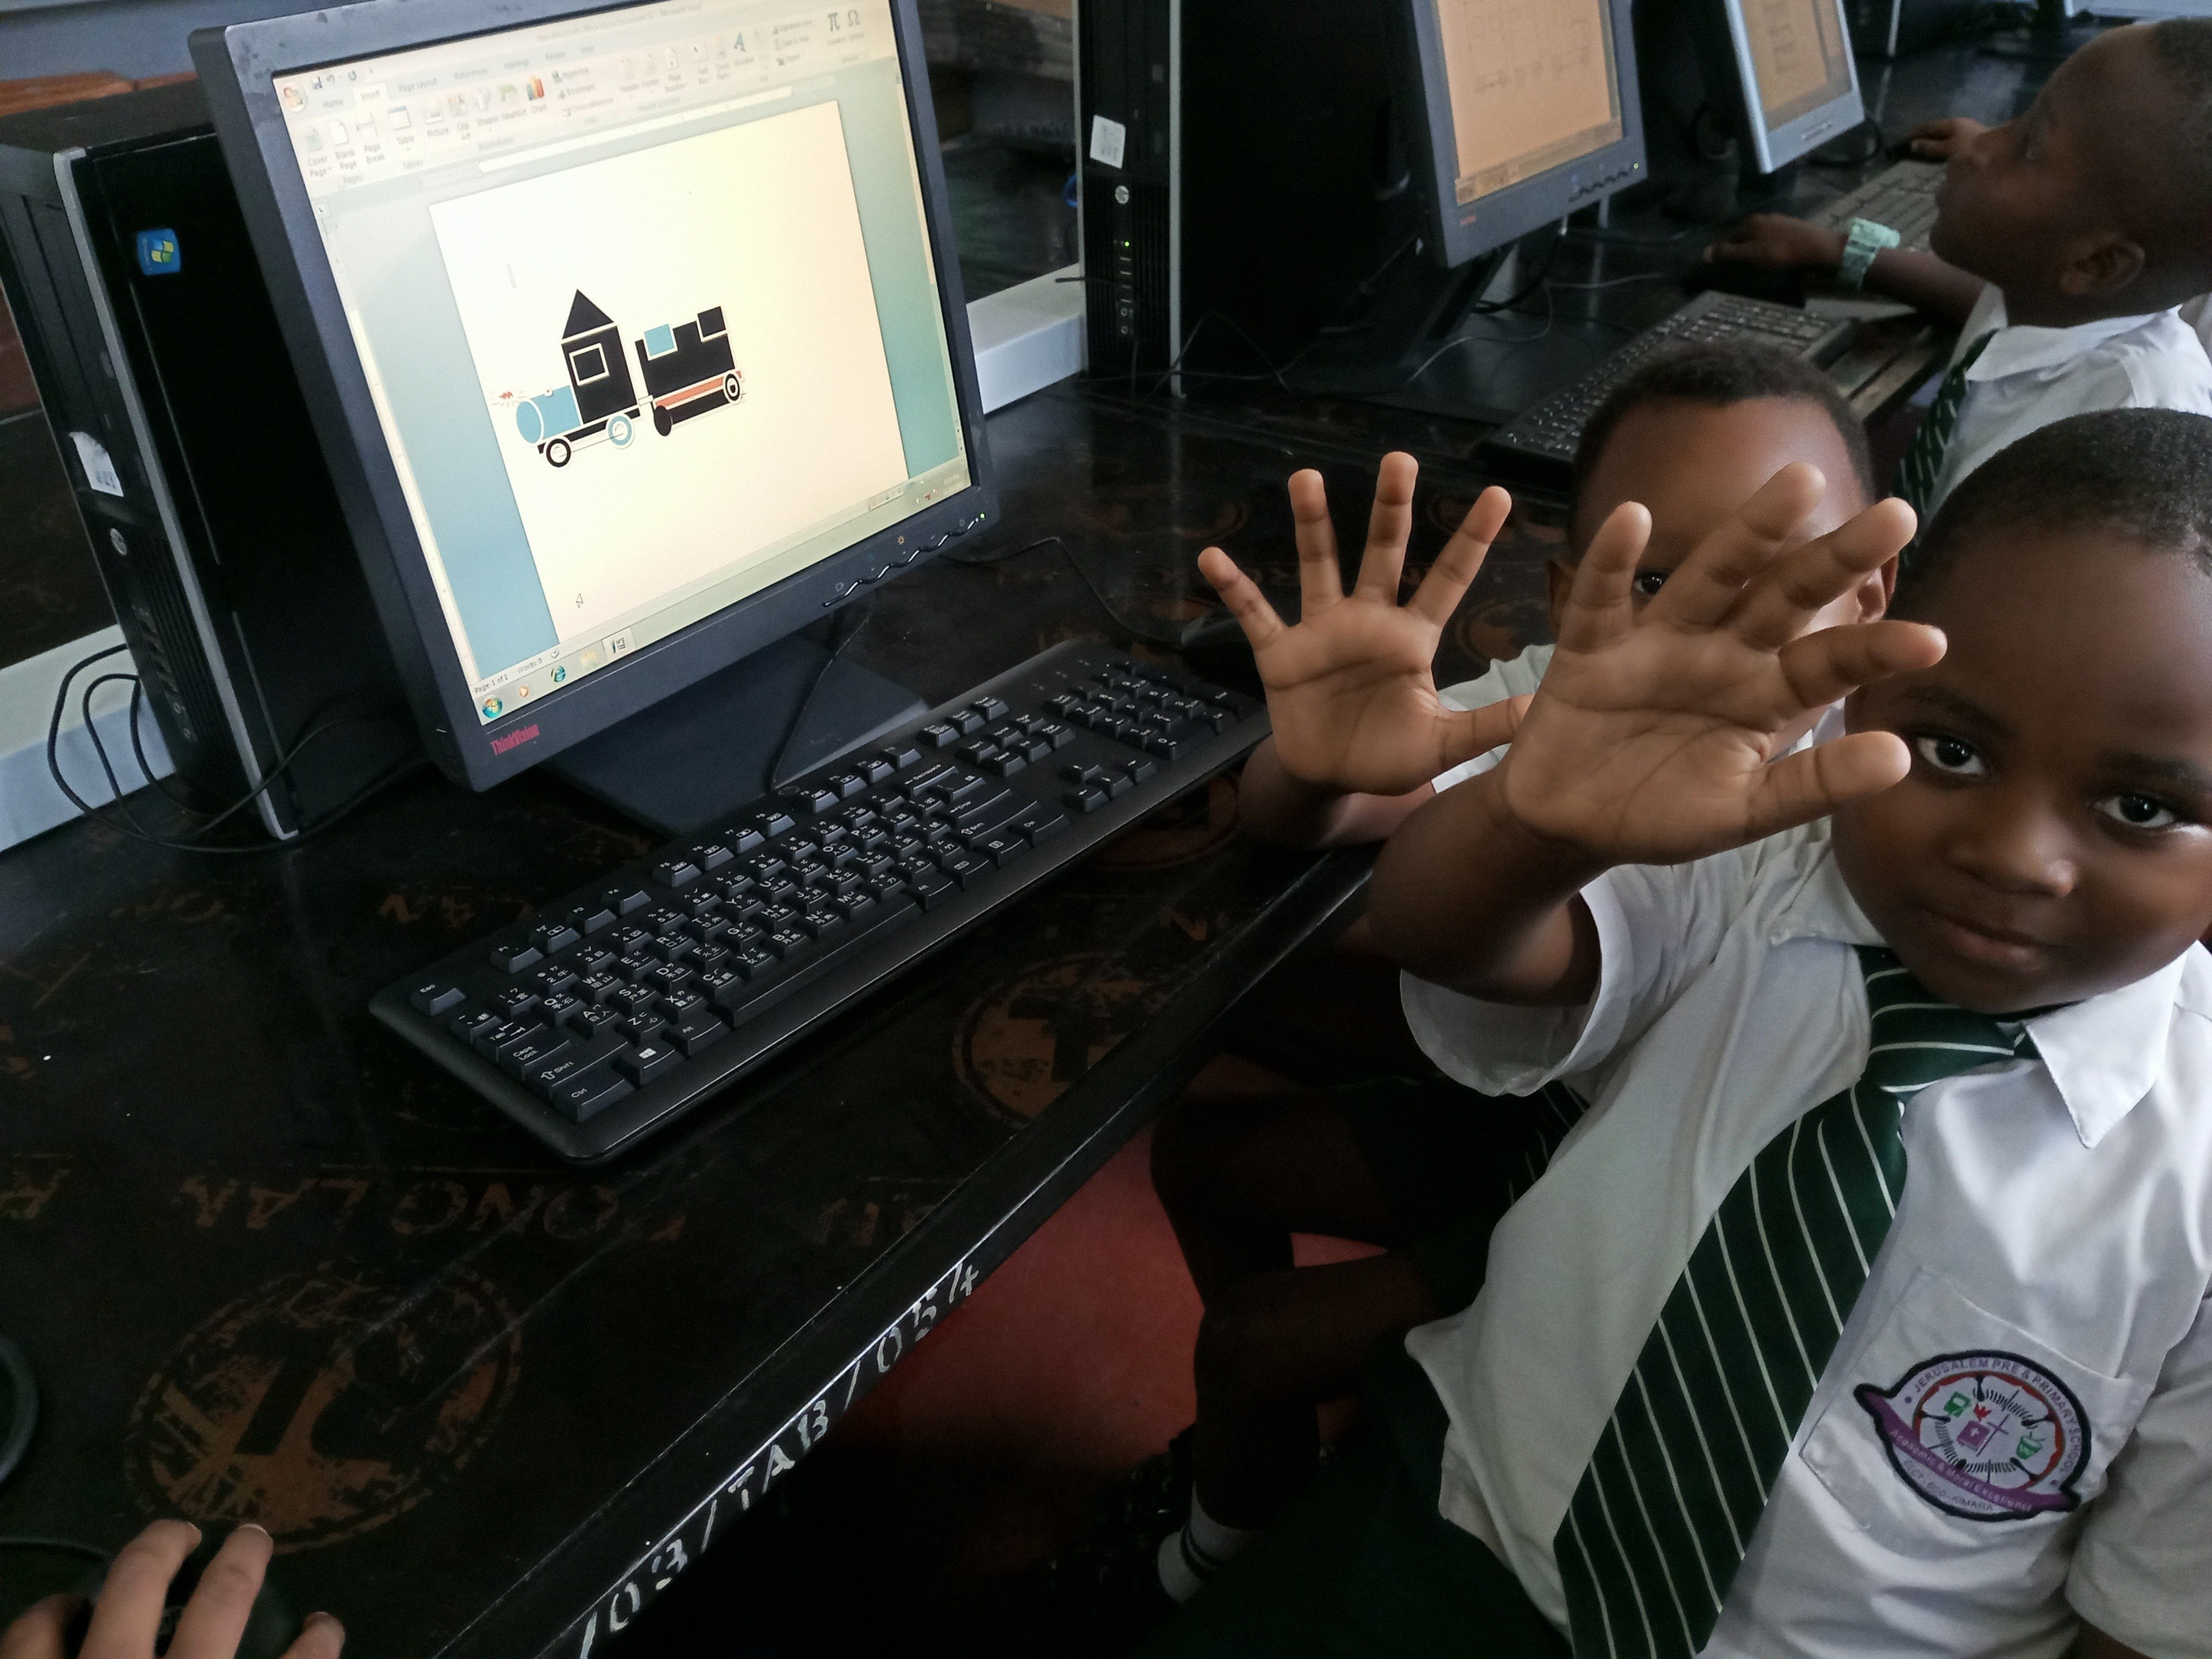
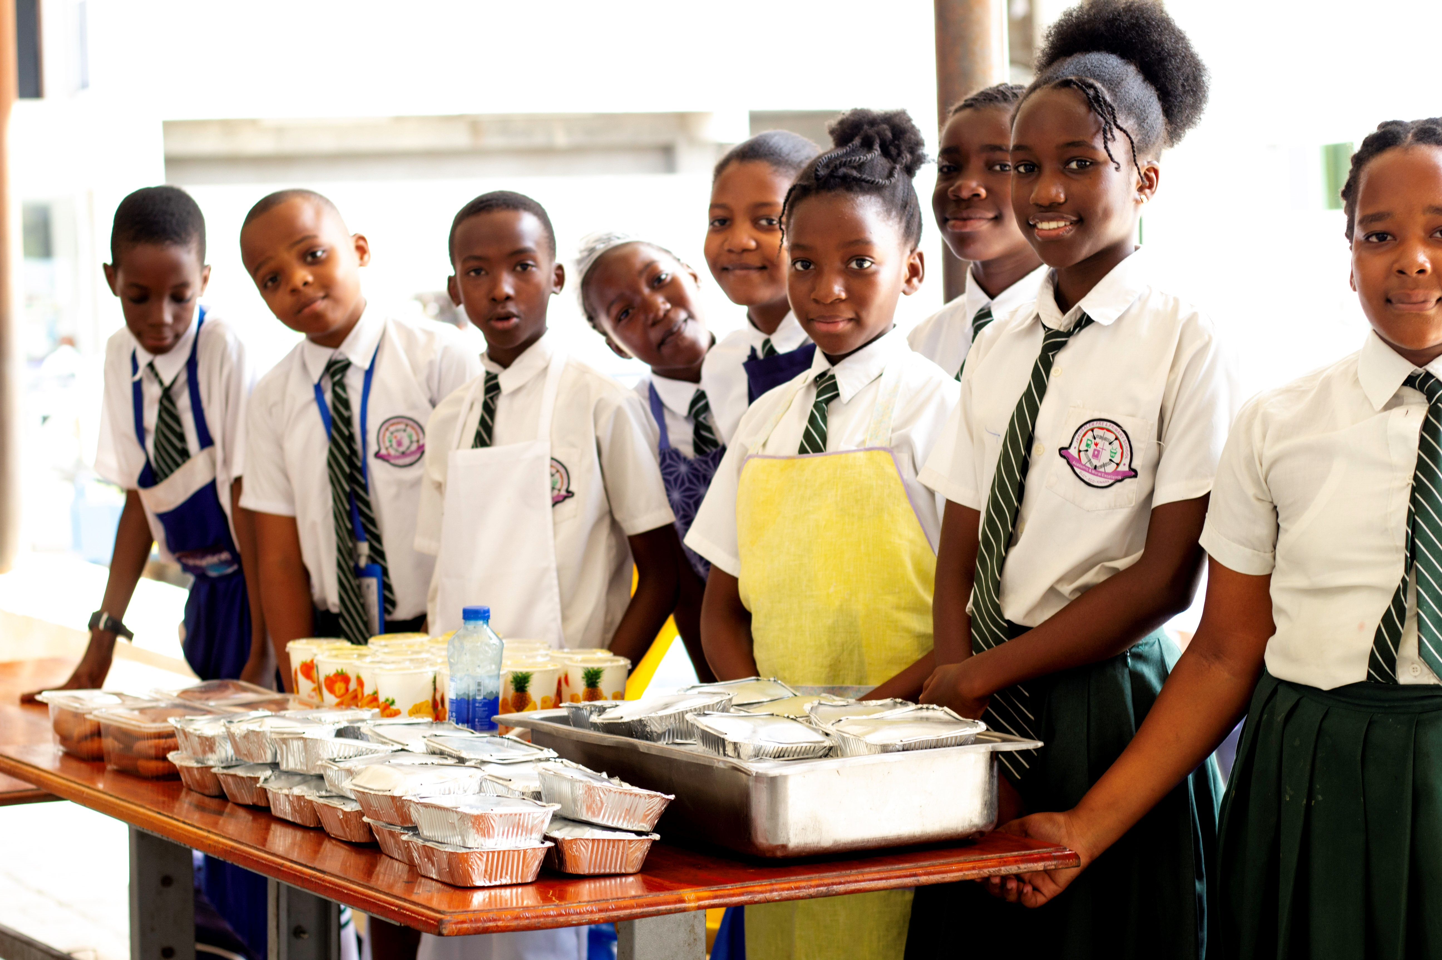
CREATIVITY

Slide 26
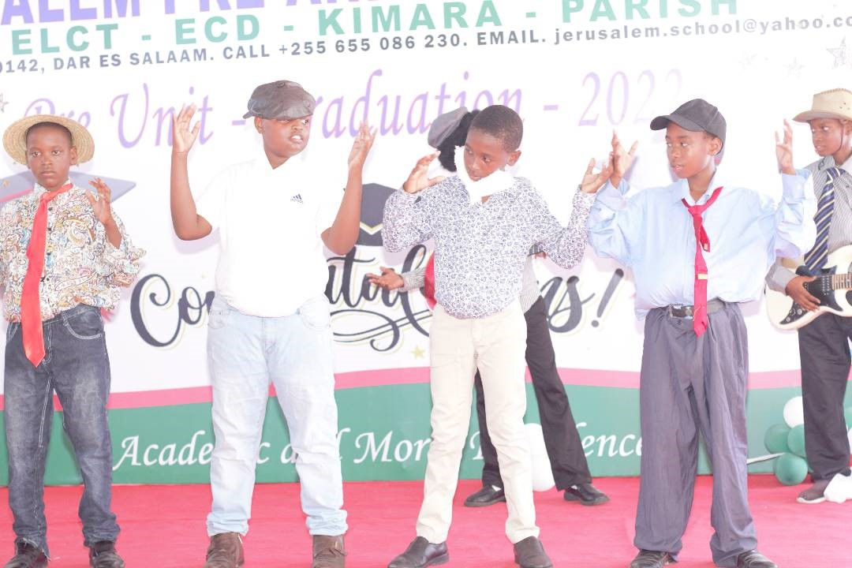
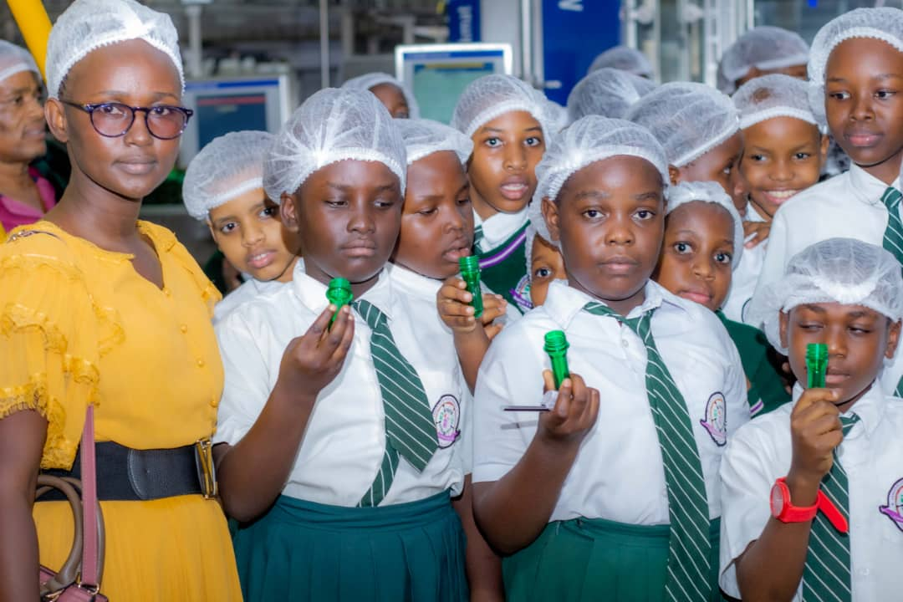

Slide 27
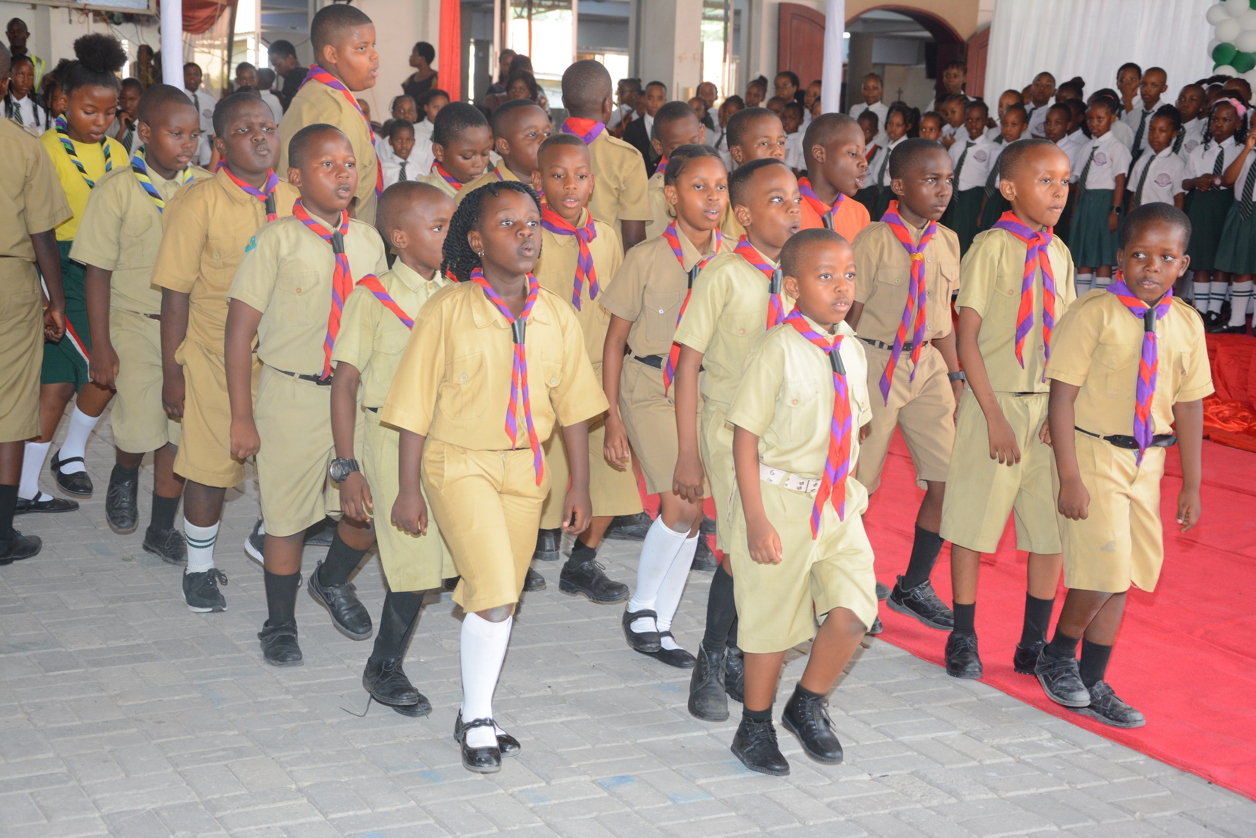
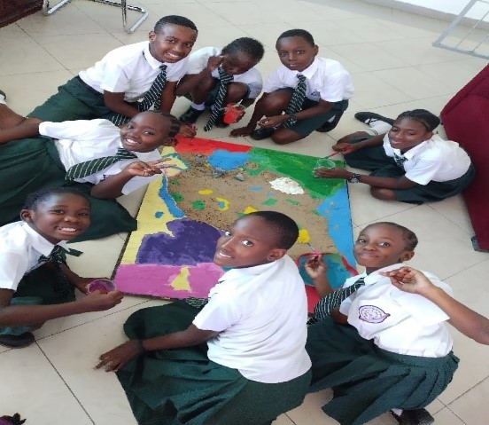

Slide 28
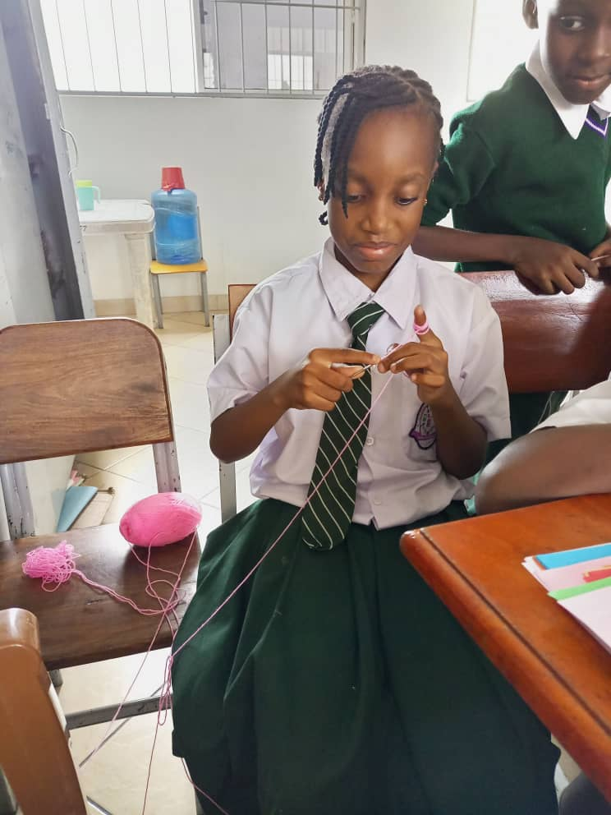
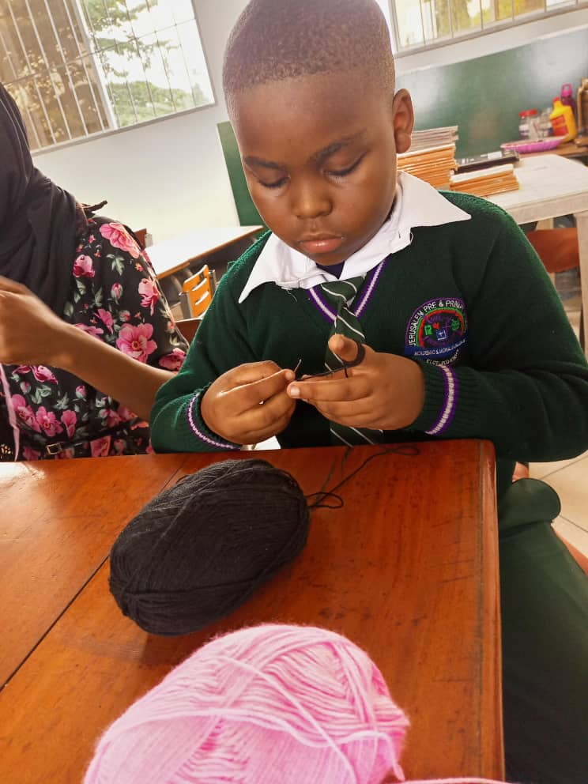

Slide 29
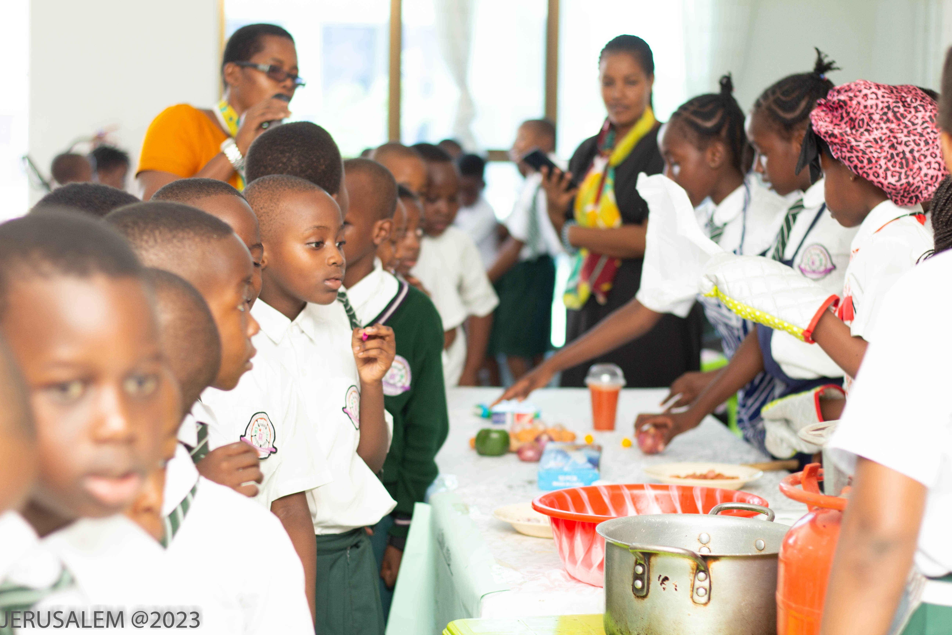
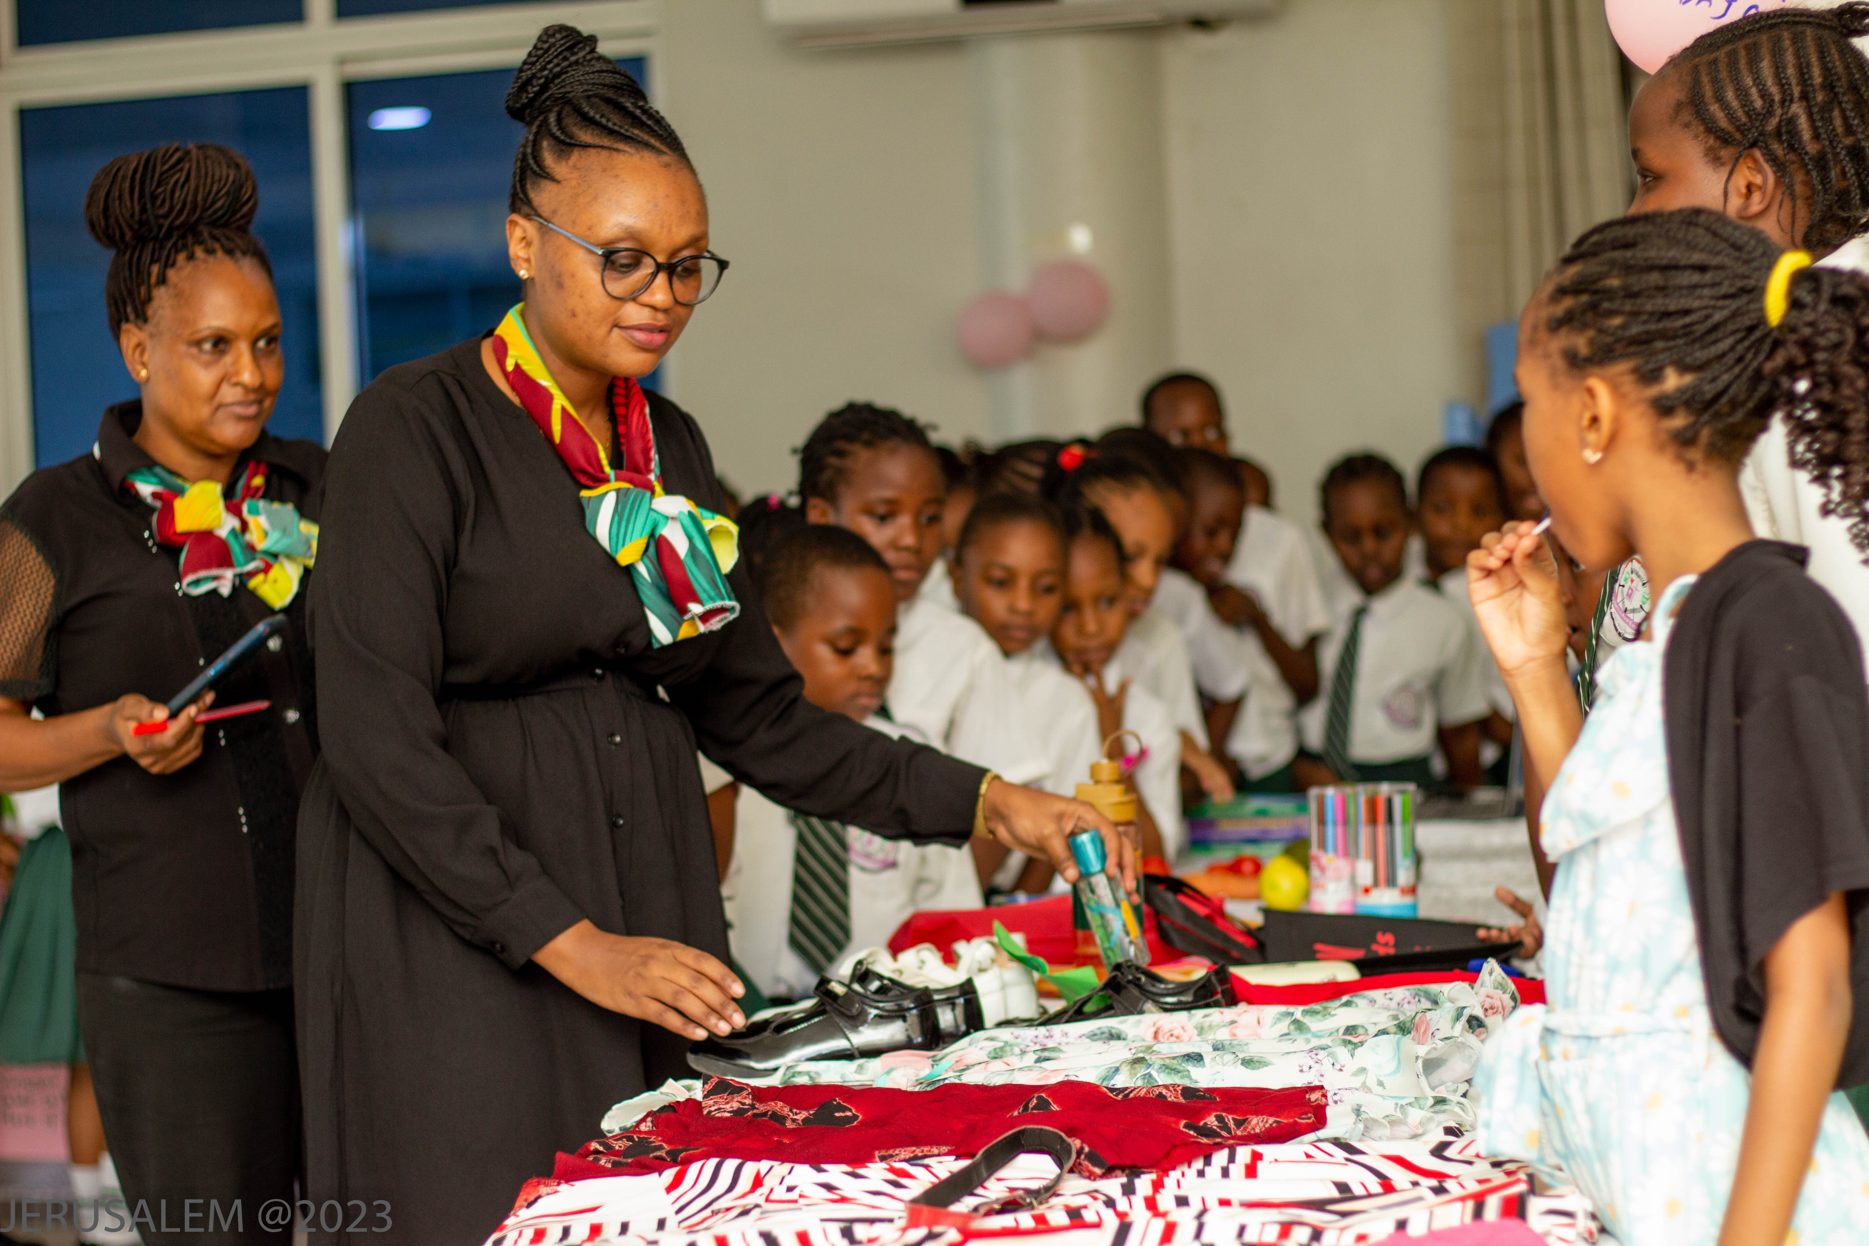
EXIBITIONS

Slide 30
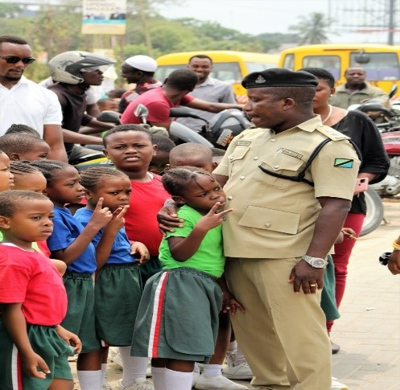
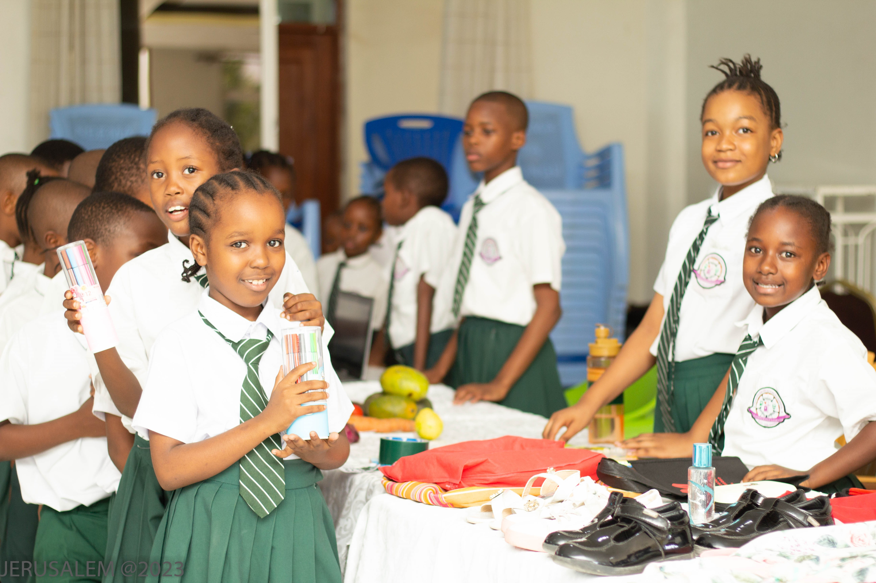

Slide 31
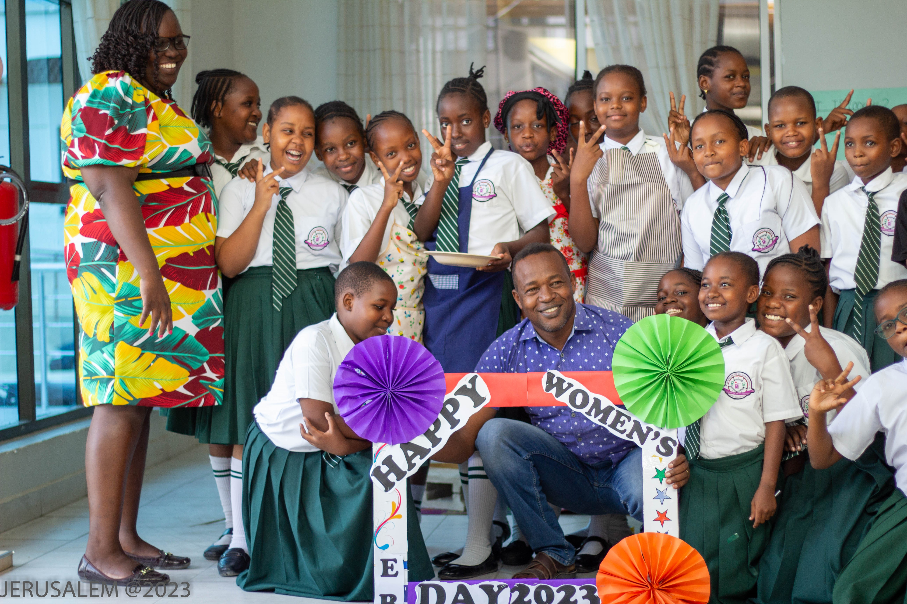

Slide 32
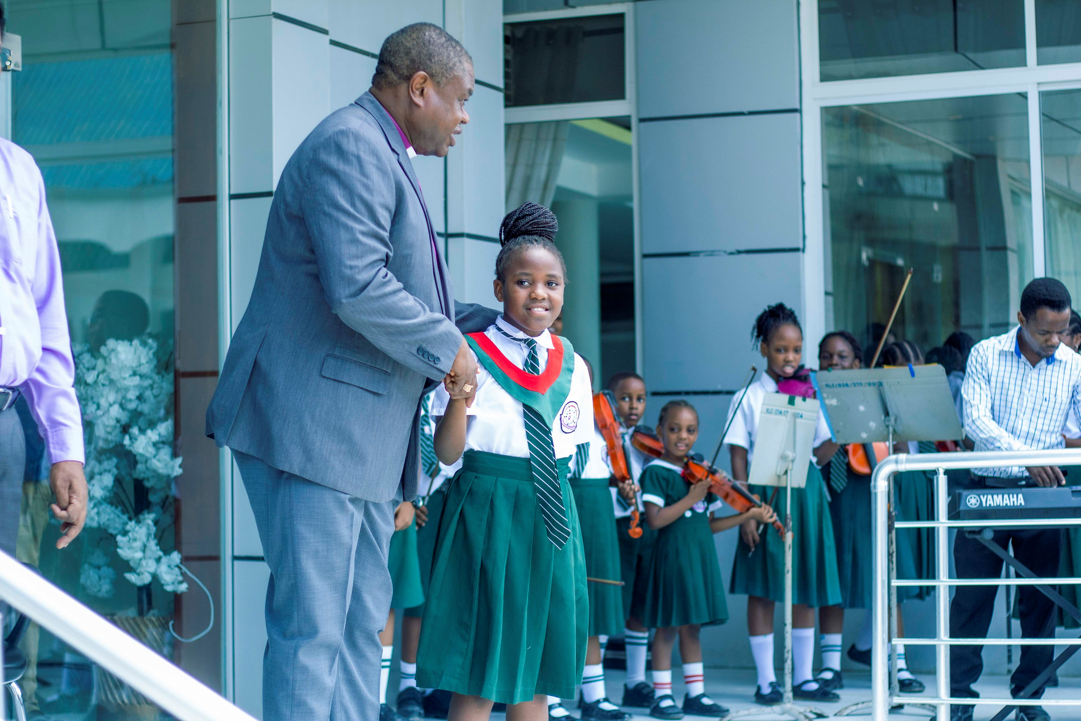

Slide 33
